Slide 1
Welcome to our Reception workshop

Slide 2
Important Information
Reading Books: These are changed weekly. Please see the guidance sheet for additional activities to support reading at home. Children are currently given a share book to be read to at home. Once the children have learnt more sounds they will bring home a book to try and read themselves.
Leave share books and home school diaries in book bags. Book bags to be in school everyday.
Children will bring home a certificate for reading milestones (e.g. 25, 50, 75, 100). This is tracked on class and school displays.
Ensure clothes and footwear are labelled.
Talk through lunch choices with your child before the start of the day.
Notes:
Bookbag check

Slide 3
Important Information
Ensure the office have an updated list of contact numbers
If someone different is collecting your child, we must be informed and that person must bring ID if they are unknown to staff.
The school office must also be notified if your child is attending an appointment during school time and of any absences. Proof of appointment must be provided.
*There is a 48 hour rule with sickness*
Please let us know if your child has come into contact with childhood illnesses such as chicken pox.
Notes:
Bookbag check

Slide 4
Important Information
PE – Tuesday and Fridays
Please ensure your child has a full kit in school before half term. Please make sure all clothing is named. No earrings to be worn and hair should be tied back.
Additional items required:
Wellies
Spare change of clothes – including underwear and socks.
Book bag everyday – Please check this for letters daily.
Return the reading book and reading record daily.
All items to have names written in them.
Water bottles – named and where possible – plain water.

Slide 5
Important Information
After October half term, the children will walk through the main pupil entrance on the Key Stage One playground independently. There will be a member of EYFS staff on the playground everyday if you need to speak to someone or pass on a message.
Class teachers will be waiting at the classroom doors for the children.
We ask that children walk through the doors independently, so that the main pupil entrance isn’t blocked.
We politely ask all parents to wait behind the red line.

Slide 6
Important Information
Our Behaviour System:
Staying on Green, Going for Gold!
All children start everyday on green. They will stay on green for example by showing a good learning attitude, listening to adults, being a good friend, working hard etc.
Children also have the opportunity to move onto bronze, silver and gold. For bronze and silver level children will receive a sticker and for gold children will be sent to a senior member of staff to receive a sticker and certificate. They will receive their certificate in a weekly celebration assembly.

Slide 7
Important Information
Our Behaviour System:
Staying on Green, Going for Gold!
If your child does one of the following they will come ‘out of green’ and need to work their way back to the green traffic light:
Wasting learning time
Talking while the adult is talking
Distracting other children
Not following instructions etc.
Not making a good choice in class or at lunchtime.
Not listening during carpet time

Slide 8
Important Information
Our Behaviour System:
Staying on Green, Going for Gold!
Amber
A child may get moved to amber if they have shown persistent get back to green behaviours.
They may have shown one of the following behaviours- Verbally hurting another child, being rude to adults, lying, play fighting etc.
Your child may have had a consequence along with the amber e.g. time out, loss of playtime.

Slide 9
Important Information
Our Behaviour System:
Staying on Green, Going for Gold!
Red
If a child has persistent amber behaviours they will be moved onto the red stage.
Examples of these may include- physically hurting another child, throwing objects, violence, swearing, etc.
The child will be spoken to by a senior member of staff. You will receive a phone call home to inform you that your child is on red and why they are on this level.

Slide 10

Ten Town
Ten Town is a great way to introduce basic maths concepts to children as young as 3 years old, right through their Early Years and into Year 1.
Ten Town provides lots of activities that enable children to use maths in real-life situations. The online games also encourage problem solving, reasoning, counting, patterning and much more!

Slide 11
Ten Town
Children can access Ten Town at home on a laptop, tablet or a phone. Log in details can be found in your child's home school diary.
As your child completes the activities on Ten Town, they will receive special stickers/certificates to celebrate their number work!

Slide 12
Ten Town
Here is a clip explaining Ten Town Home Access.
https://www.youtube.com/watch?v=XpJuh4Jq6sY
Your childs’ log in can be found at the front of the Home School Diary.

Slide 13
Read Write Inc.
Read, Write Inc is a phonic programme that is taught everyday. The children will learn sounds letters make and then use this knowledge to start reading words. They will also take part in daily letter formation practise which will support their writing.
We teach the children simple ways of remembering these sounds and letters. Ask them to show you what these are.
The letters we are learning each week will be uploaded to Tapestry along with useful videos.
Resources and Information on Read, Write, Inc can be found in your packs.

Slide 14

Read Write Inc.
Let me introduce you to Fred.
Fred can only speak in sounds. He says d-o-g, h-a-t etc.
Speaking like Fred helps children to understand that words are made up of sounds.
Fred helps children practise blending sounds together because he needs the children to say the words for him. Fred says d-o-g, children tell him the word is dog.

Slide 15
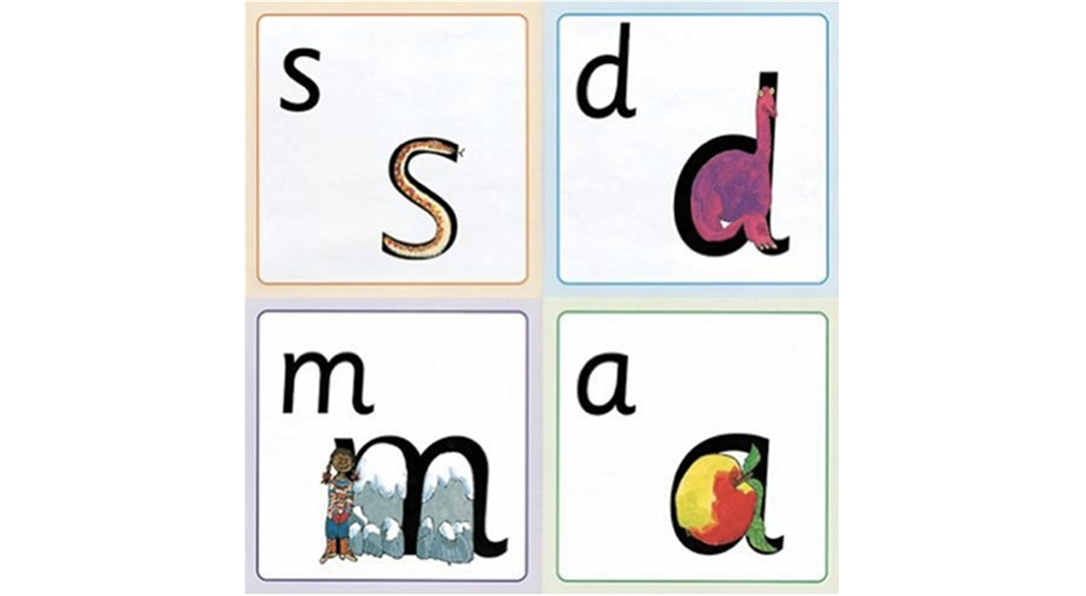
Read Write Inc.
We give children a hook to learn the sounds by using pictures in the same shape as the letter.
‘s’ looks like a snake.
‘d’ looks like a dinosaur.
‘m’ looks like a mountain.
‘a’ looks like an apple.
We teach the children to name the mnemonic pictures before they learn the sound.
This means that children learn to read and write the sounds really easily.

Slide 16
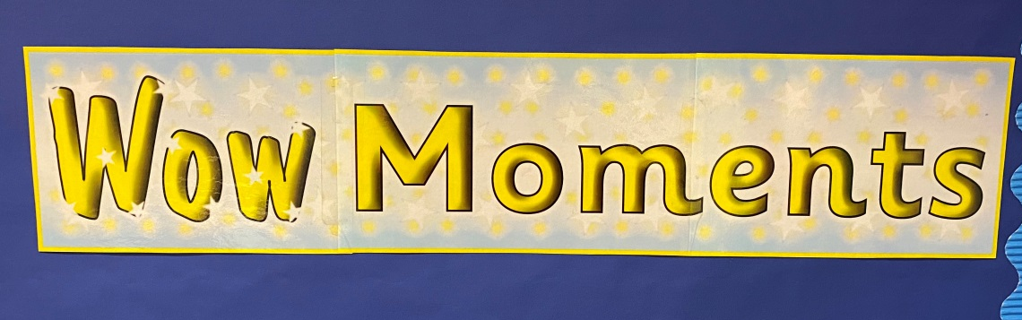
Wow Moments
If your child does something “wow” at home, please let us know!
Examples
Spots sounds in their share book
Writes their name
Learns to ride a bike
Moves up a class in swimming
Fill in the wow moment sheet and these will be shared with the rest of the class.

Slide 17

Tapestry
Please check Tapestry daily for important updates such as homework and special events.
We also upload photos and videos of your child so you can see what they are up to during the day. If you are having any problems with your account, please speak to the class teacher.

Slide 18
Information Pack
Read Write Inc. Sound Mat
Read Write Inc. Handwriting Rhymes
RWI terminology
Supporting reading and vocabulary at home sheet
WOW Moments Sheet
Tapestry Parent Guide
Ten Town information and Characters
Number line to practise counting and number formation
Shape poster to support naming shapes
Family Fun Day Poster – Saturday 11th October at Basildon Library

Slide 19

Visit our school website!
Visit www.ghyllgroveprimaryschool.co.uk
Here you will find everything you need about our school.
Each class has their own page; here you will find important dates, homework tasks, newsletters and curriculum information.
These pages are updated regularly with photographs of what the children have learning each week.

Slide 20

Contact Us
Phone: 01268 450067
Email: parents@ghyllgrove.essex.sch.uk

Slide 21


EYFS Raffle
We will be selling raffle tickets during the workshop – all money raised will go towards resources for the children.
20p each or £1 per strip

Slide 22
Thank You
Thank you for attending the workshop today!
You now have time to work with your child in the classroom – please access the activities at the tables (areas around the classroom i.e. home corner, construction area etc. are closed)
Please complete a feedback form before you leave.
Many Thanks.

