Slide 1

Welcome to Year 1
Parent workshop

Slide 2
Aims:
Meet the Year 1 Teachers
Know the curriculum your child will be taught this year
School behaviour system
RSE in Year 1
How to support your child at home

Slide 3
Year one staff
Miss Porter – Key Stage One Lead and Class 5 teacher
Mrs Mahadeo – Class 4 teacher
Ms Partner – Class 6 teacher

Slide 4
SENCO
Mrs Greenwood

Slide 5
Maths
Maths is taught everyday in year one . The main skills we expect children to be able to do by the end of the year are; count to 100 forwards and backwards from any given number, read and write numbers to 20 in numerals and words, count in multiples of 2, 5 and 10, finding 1 more and 1 less of any number within 100, read write and interpret mathematical statements using + - and =, add and subtract numbers within 20.
Number bonds are very useful to help with many different areas of maths so in year 1, children need to know are all of their bonds to 10 and 20.
Ways to help at home would be to practise counting to 100 forwards and backwards from any number. We are going to be using the 1 minute maths app and the Maths Monkey will go home with a child once a week for the weekend. There will be parent workshops on supporting Maths at home which will include how to use 1 Minute Maths later in the half term.

Slide 6
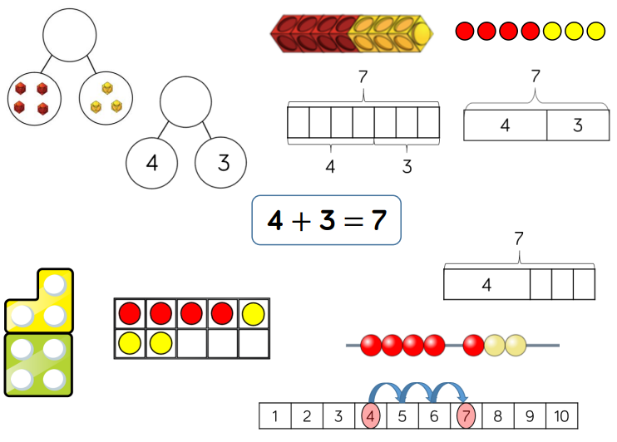
Maths

Slide 7
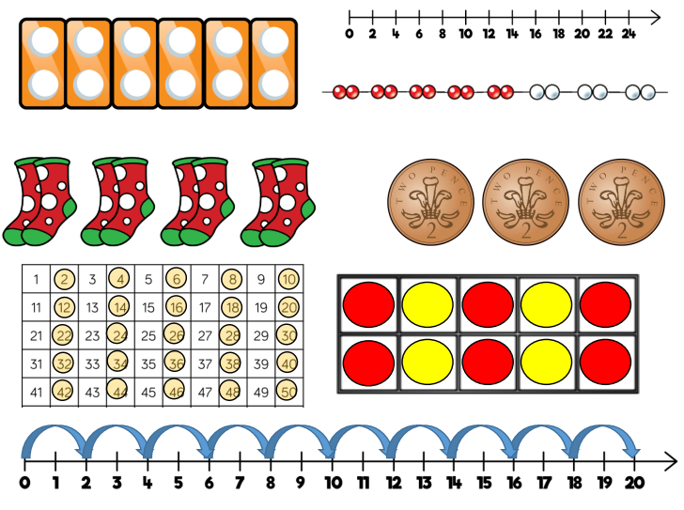

Slide 8

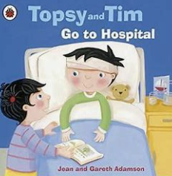

English
In year 1 English is delivered through a range of teaching styles and at times a book centred approach which helps the children engage in high level texts to inspire and develop a love for reading.
In Year 1 we use a range of texts to stimulate ideas and provide high level models. Some examples of these texts are,
By the end of Year 1 children are expected to be able to use full stops, capital letters and finger spaces confidently and consistently, write a sequence of sentences to form a short narrative and non-narrative text, read and spell all year 1 common exception words.

Slide 9
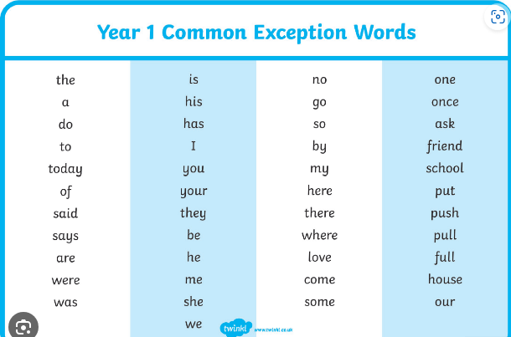
Year One Common Exception Words
On your chair you have a copy of the year one common exception words. These words will be sent home for spellings to learn every week. There are 45 common exception words that your children will need to be able to read and write by the end of year one in July 2026.
Spelling test will be every Friday.

Slide 10

Phonics and the phonics screening test.
Reading is at the heart of our curriculum!
At Ghyllgrove, we place a great emphasis on children building their fluency of reading so that they are able to access and understand the challenging texts which form our reading curriculum. We will use the Read Write Inc. (RWI) programme to get children off to a flying start with their reading and writing.
What is Read Write Inc?
Read Write Inc. Phonics is a DfE-validated systematic synthetic programme with a whole-school approach to teach early reading and writing. It integrates phonics, comprehension, writing, grammar, punctuation, vocabulary and handwriting.
Children learn to read sounds and blend them into words. They apply this phonic knowledge to read and comprehend storybooks that are carefully matched to the sounds they know.

Slide 11
Phonics and the phonics screening test.
Progress Groups
Children are grouped according to their ability across Foundation Stage and Key Stage 1 to ensure that teaching is suited to their level. Phonics in Foundation Stage and Key Stage 1 takes place on a daily basis and in Key Stage 2 where applicable.
Children work in these progress groups for 30 minutes 3 x per week and 45 mins 2 x per week, meaning they are learning at their appropriate 'challenge level' for 3 hours a week. Reception build up to this throughout the year.
Intervention
The aim of Read Write Inc Phonics is for children to learn to read early. However, even with the best teaching and the best programme, there are some children who need extra practice to keep up. We accelerate the progress of these children with 10 minutes one-to-one tutoring every day. However long it takes, we don't give up!
In year 1, children will sit a formal phonics screening test around June, this is made up of 40 words they have to read using the sounds from phases 2-5 that they have learnt throughout the year. There will be more information about this later in the year.

Slide 12
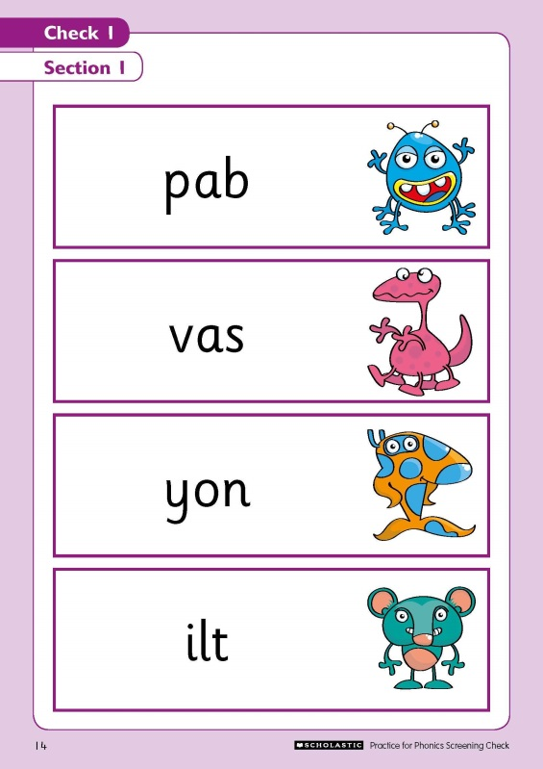
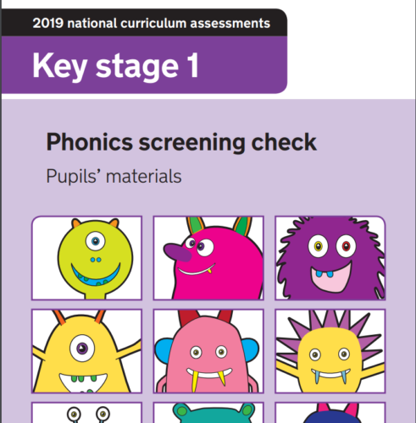
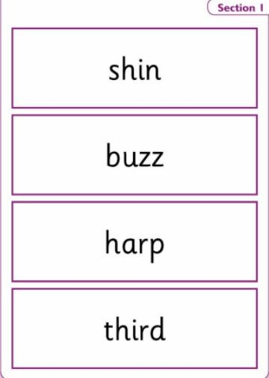
Phonics and the phonics screening test.
In year 1, children will sit a formal phonics screening test around the beginning of June, this is made up of 40 words they have to read using the sounds they have been taught during their Read Write Inc lessons throughout the year. There will be more information about this later in the year.

Slide 13
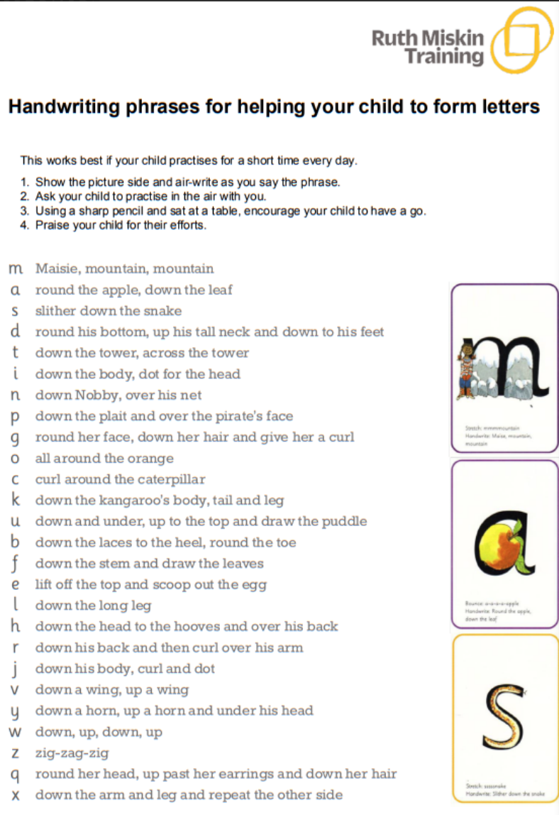
Phonics and the phonics screening test.
Handwriting phases

Slide 14
Reading and English at home
Please help your child at home by asking them to read to you at least four times a week at home and sign their home school diary.
The expectation for reading at home is that your child reads a few pages to you, a minimum of four times a week, we count how many times you have read at home (this does not include multiple books or times read in one day, as we want reading spread over the week for a ‘drip feeding’ approach).
Reading is made up of a few individual skills that all need to be developed for children to become well rounded readers, the application of their phonics and word recognition, fluency and comprehension.
Certificates will be awarded weekly for those reading three times in the week and when they reach a milestone of 25, 50,75 etc. They will earn a large certificate that is awarded in assembly.
It is important to share books with the children, read books to them and listen to them read as it promotes a love for reading that will help them in their education journey.
Encourage and support them to practise their weekly spellings as they will be tested on these every Friday, with their sheet coming home for you to see.

Slide 15
Spellings
In Year 1 the children will come home with weekly spellings on a Friday. At home we would like you to practise these spellings with your child and then they will have a spelling test the following Friday.
The words will begin with Year 1 common exception words and then they will start spellings from RWI.
Every Friday they will come home with their spelling test so you can see how well they have done.

Slide 16
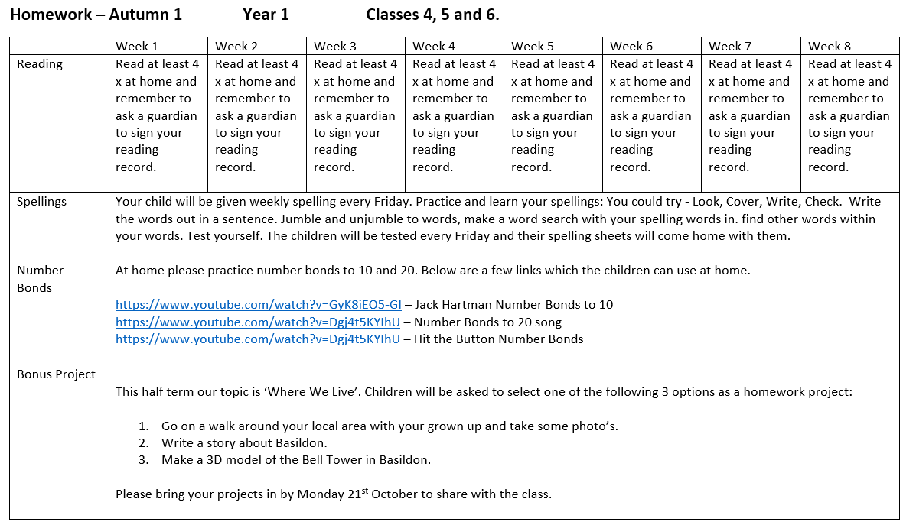
Half termly homework sheet.

Slide 17
Topic – Foundation Curriculum
In year 1 children will be learning new skills and building knowledge of history, geography, science, art, music and DT through 6 topics this year.
The topics are:
Where We Live | Whatever The Weather | Toy Museum | Ghyllgrove Gardeners | All Aboard | Wonderful World
Children also follow a computing curriculum where they learn about E-Safety and a variety of computer based programmes such as paint.
They are also taught about religion through RE which follows the Discovery Scheme of work and in year 1 we learn more about Christianity and Judaism.
PE will be taught twice a week and children will learn progressive skills through games, dance and gymnastics sessions. They will need the correct PE kit of red shorts and a white t-shirt and trainers for indoors and a plain back joggers and jumper (tracksuit) and trainers for outdoor PE.

Slide 18
Year 1 PE days
Class 4 | Class 5 | Class 6
Wednesday and Friday | Monday and Friday | Wednesday and Thursday

Slide 19
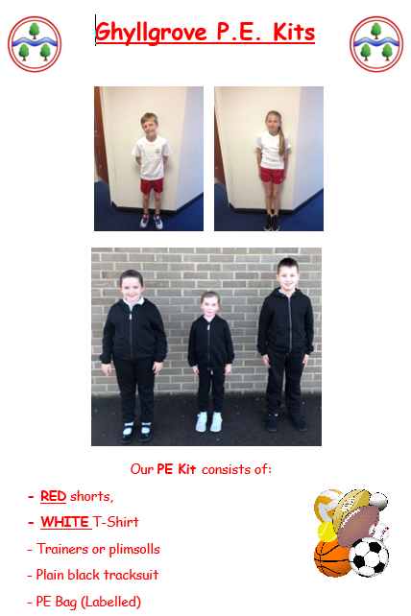

Slide 20
Foundation Curriculum – School Trips
Where We Live | Whatever The Weather | Toy Museum | Ghyllgrove Gardeners | All Aboard | Wonderful World
Within our topics we will be going on school trips once a term. These will be both local/community for example visiting the town centre or library and trips where will be travelling on a coach.
When we are going on a trip whether it be local or a coach journey, parents will always be informed before hand.
Our school is a cashless school so all trips will need to be paid for using ‘School Money’ which is on our school website. If you are unsure about this then please contact the school office and they will be able to assist you.

Slide 21
Forest School
Throughout the year the children will have the opportunity to visit our Forest School.
On the week of forest school the children will be expected to have a spare change of clothes that they can change into.
The spare clothes will need to be suitable for exploring forest school such as long sleeved tops and in winter months wellington boots.
We will send a text out to notify you when your child’s class is taking part in forest school.

Slide 22
RSE in Year 1
It is now statutory that all children learn about relationships and sex education.
As a school we follow DfE guidance on what should be taught and have planned a curriculum that best fits the needs of the children at each stage of their development.
In year 1 it is very much built around friendships.
In year 1 children will learn life skills such as; personal hygiene and sun safety. Recognising the human life cycle, simple home safety, recognise and talk about their different emotions, the importance of families and how to ask for help, good manners, how our behaviours affect the environment and personal aspirations.

Slide 23
Behaviour school rules rewards & sanctions
7 daily habits
The school behaviour system is consistent throughout the primary school and you will expect to see Green Certificates at the end of the week. The certificate is green is an excellent conduct award which shows that they have made excellent choices all week- this is something that is celebrated when the certificates are given out on a Friday afternoon. If your child comes home with a yellow certificate, this means that they have been on amber twice which is where they have not made the correct choices in school and have had to have reminders about their behaviour. This is a good conduct certificate. Your children’s green certificate will goes towards them earning a bigger certificate at the end of every half term.
In school children will learn the school rules and learn how to make good, kind and respectful choices. There are many rewards for following school rules and making good choices such as positive praise, stickers, golden time, team tokens, certificates and bronze, silver and gold awards. This year children have the chance to win the Headteachers Special Award for outstanding behaviour in school. If your child is picked for an Headteacher award then they are invited to have hot chocolate and biscuits with our school’s headteacher.
There are sanctions when the school rules are not followed and children know what these are. When children lose all three chances in class or break a school rule they can receive an amber and for more serious behaviours a Red. Please look out and praise your child when they receive a green certificate. If they do not bring a certificate home it could be worth checking with the teacher why not if they have not already spoken to you.

Slide 24

Ghyllgrove Learning Powers
We embed these learning powers into the children’s learning and they are always referred to, especially if they are finding their learning tricky. You might hear them say these at home too.

Slide 25
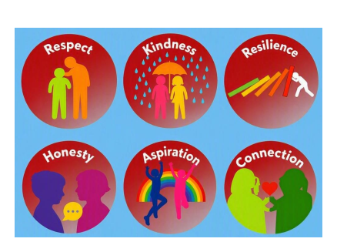
Our School Values

Slide 26
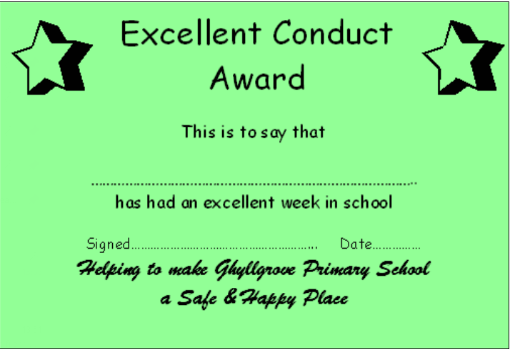

Excellent conduct award and good conduct award.

Slide 27
Uniform
We do expect all children to come to school wearing the correct uniform.
Please could you ensure that all school uniform is named, this includes P.E kit.
More information can be found on our website:
https://www.ghyllgroveprimaryschool.co.uk/school-uniform-and-pe-kit

Slide 28
Home Time
Please ensure that you remain behind the red line on the playground when collecting your children at the end of the day.
If you would like to speak to your child’s teacher please ask your child to let the teacher know.

Slide 29
If you have any concerns or worries please email on the school email address parents@ghyllgrove.essex.sch.uk or call into the school 01268 450067 and we will arrange a time to talk with you.

