Slide 1

Welcome to Year 4
Parent workshop

Slide 2
Aims:
Meet the Year 4 Teachers
Know the curriculum your child will be taught this year
School behaviour system
RSE in Year 4
How to support your child at home

Slide 3
Maths
Summary of Maths expectations for the year group.
Children are confident and know all the written methods for the 4 calculations.
Children are expected to understand common fractions and solve simple calculations involving fractions.
They will begin to look at decimals and fractions equivalents.
Children to apply arithmetic skills when solving reasoning problems.
Times tables expectation.
In June the children will sit the MTC.
By the end of Year 4 all children are expected to know all their times tables up to X12.
Children can use TTRS to help with their times tables recall.

Slide 4
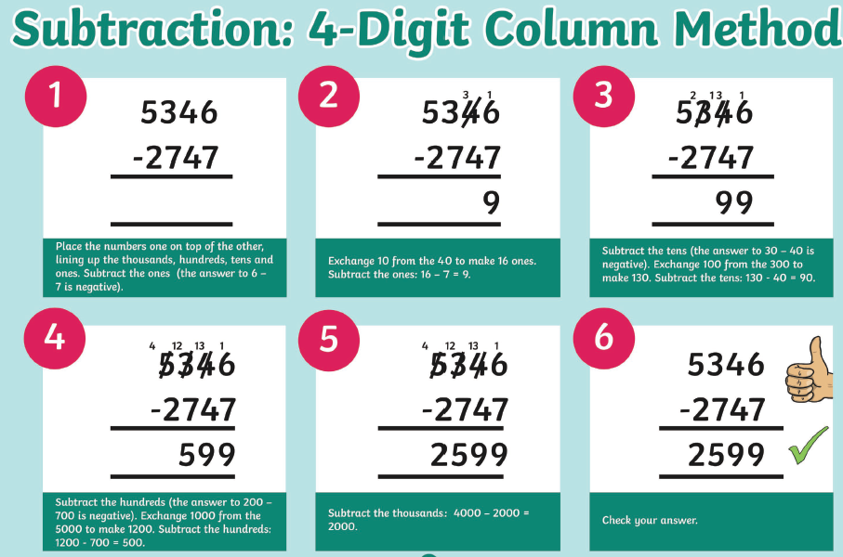

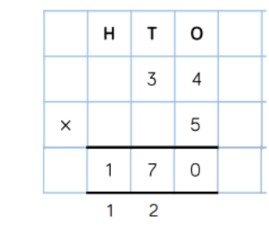

Maths

Slide 5
English
In year 4 English is delivered through a book centred approach which engages the children in high level texts, stimulates their creative writing ideas and gives a model for spelling, punctuation and grammar.
These texts are: The Iron Man, Beaver Towers and How to Train your Dragon – How to be a Pirate.
Children will be taught how to read fluently and with expression in their fluency lessons and taught the key skills of comprehension
By the end of Year 4 children are expected to be able to organise their ideas in paragraphs, ensure their writing is coherent and their writing has a clear structure.
Read a variety of texts fluently and with expression
Read for understanding by retrieving information and begin to use clues in the text to answer questions
Spell phonetically plausible words and common exception words for 3 & 4
Use capital letters, full stops, commas in a list, question marks, exclamation marks demarcate a range of sentences
To use commas to mark adverbial phrases and subordinate clauses
Use adjective, adverbs, exciting verbs and a variety of conjunctions within their writing

Slide 6
Helping at Home
Help your child practise their times tables. Little and often works best.
Encourage your child to use TTRS at home.
Please help your child at home by asking them to read to you at least four times a week and sign their home school diary so they can achieve their reading certificates.
Share books with them and read books to them – these can be their school reading book, a book from home or the library.
Practise their weekly spellings.

Slide 7

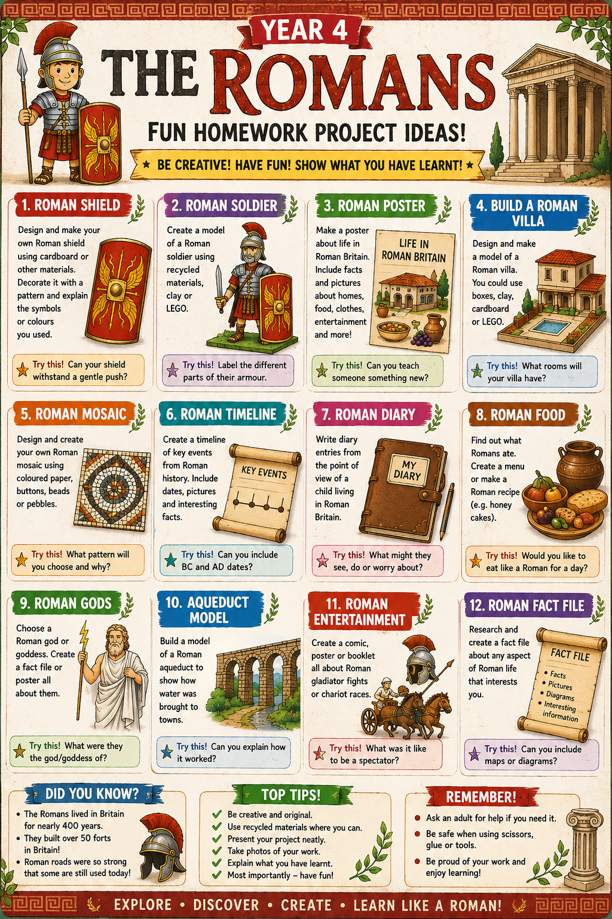
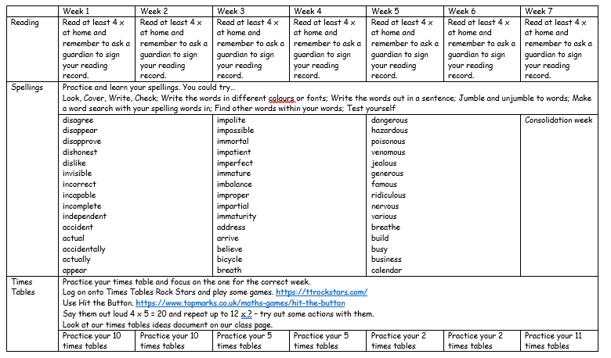
Helping at home…

Slide 8
Foundation Curriculum
In year 4 children will be learning new skills and building knowledge of history, geography, science, art, music and DT through 6 topics this year.
The topics are:
Rocking Romans | Mad Scientists | Rock Stars | Essex Explorers | WWII | What's that living thing?
Children also follow a computing curriculum where they learn how to keep themselves safe and a range of computer literacy skills, including typing, copy and paste, searching, saving and opening work; photo editing and animations; coding.
They are also taught about religion in RE, following the Saffron Scheme of work. Children explore religion through different lenses, focusing on Theology, Philosophy and Human and Social Science. In Year 4, we focus on a wide variety of world religions, including Christianity, Sikhism and Hinduism. This helps the children to develop an understanding of different people in their community.
Children continue to learn French through a range of topics including Portraits, Clothes and Numbers, Calendars and Birthdays. We also learn about other countries and cultures through our language of the month.

Slide 9
Foundation Curriculum
PE will be taught twice a week and children will learn progressive skills through games, dance and gymnastics sessions. For Year 4 one of the PE lessons is swimming.
They will need the correct PE kit:
Red shorts
White t-shirt
Trainers
Plain back joggers and jumper (tracksuit) for outdoor PE in colder weather
Our PE days are:
Class 13: Friday
Class 14: Friday
Class 15: Thursday

Slide 10
Swimming
Swimming takes place every Wednesday or Thursday afternoon. Children will only swim in Year 4. We hope the consistency in swimming weekly helps children gain confidence in the water.
By the end of Year 4 the expectation is that all children will be able to swim 25m in a stroke of their choice.
Children need to bring appropriate clothing for the weather for walking to the swimming pool.
Class 13: Thursday
Class 14 and 15: Wednesday

Slide 11
RSE in Year 4
It is now statutory that all children learn about relationships and sex education and guidance has been updated.
As a school we follow DfE guidance on what should be taught and have planned a curriculum that best fits the needs of the children at each stage of their development.
Through our RSHE curriculum, pupils learn how to recognise safe, respectful and positive relationships, seek help from trusted adults when needed, stay safe online and understand the physical and emotional changes that occur as they grow up.
In year 4 children will learn:
Health and well being – how to stay physically and mentally healthy
Relationships – how to build trusting friendships and understand other opinions an feelings, understand consent, families and how families can change and be diverse.
Being Safe – both online and in day to day living
Living in the wider world – money management and the environment
Aspirations - to know how to set goals and achievable targets.
Changing & Growing up: Personal hygiene & emotions. Children will also recap the NSPCC PANTs for ages 7-9 around building confidence.
If you would like to discuss any of this content or see any content please talk to the class teacher and visit the website which is being updated this year to show changes to the RSE curriculum.

Slide 12
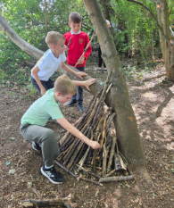
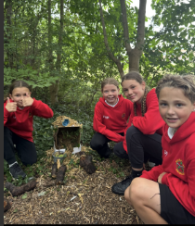
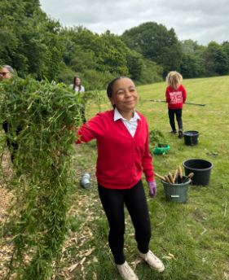
Forest School
This year Forest School is starting up for every year group.
Forest School is the opportunity for children to learn about the outdoors. Learning facts about nature and local wildlife, growing an appreciation for these and engaging in enriching experiences outside of the academic curriculum.
Each year group will have a week of afternoons at Forest School. These sessions will be held in the developed woodland at the bottom of the field.

Slide 13

These sessions will happen rain or shine.
Your child will need:
Forest School
Long trousers (shorts are not allowed)
Closed shoes that can get muddy – old trainers, wellies, walking boots
Top that can get muddy.
Rain coat if it is raining.
Hat if it is sunny.
Please check the forecast in the morning to make sure you send the appropriate clothes in for that day.

Slide 14

Forest School Times
A letter will be sent out the week before your child’s class attends Forest School. Please ensure your child brings in their forest clothes everyday for their forest school week.
Summer 1 – Year 4

Slide 15
Trips, Workshops and Visitors
Autumn
Colchester Castle - £12
Royal Albert Hall – Concert
Spring
School of Noise
LEGO Workshop
Summer
Artist Workshop
Owl Pellet Dissection
Library visit
The cost of all workshops and trips in red is covered by the school.
Please ensure all allergy and medical records are up to date via the office.

Slide 16
Behaviour
The school behaviour system is consistent throughout the primary school and you can still expect to see Green Certificates at the end of the week.
In school, children will learn the school rules and learn how to make good, kind and respectful choices. We will strive to show our Ghyllgrove Learning Powers and our School Values. There are many rewards for following school rules and making good choices such as positive praise, stickers, golden time, team tokens, certificates and bronze, silver and gold awards. This year children have the chance to win the Headteachers’ Special Award for outstanding behaviours in school.
There are sanctions when the school rules are not followed and children know what these are. When children lose all three chances in class or break a school rule they can receive a verbal warning and for more serious behaviours a written warning. Please look out and praise your child when they receive a green certificate and a yellow certificate. If they do not bring a certificate home it could be worth checking with the teacher why not if they have not already spoken to you.

Slide 17


School Values
The school environment and school behaviour systems are underpinned by core values and learning styles.
This is the language we will use in promoting the children’s self-esteem, desire to learn and behaviour choices.
These are at the heart of Ghyllgrove, our vision and everyday life in school.

Slide 18


Keeping up to date

Slide 19
If you have any concerns or worries please email or call into the school and we will arrange a time to chat with you. parents@ ghyllgrove.essex.sch.uk

