Slide 1

Welcome to Year 3
Parent workshop

Slide 2
Aims:
Meet the Year 3 Teachers
Know the curriculum your child will be taught this year
School behaviour system
RSE in Year 3
How to support your child at home

Slide 3
Maths
By the end of Year 3 children are expected to:
Read, write, compare and order numbers up to 1000 in digits and words.
Understand place value in 3 digit numbers up to 1000.
Add and subtract numbers up to two 3 digit numbers (for example 854-273).
Add and subtract small amounts and multiples of 10 and 100 mentally.
Multiply and divide 2 digit numbers by using their times tables skills.
Find fractions of objects, shapes and amounts.
Add, subtract, compare and order fractions.
Measure, compare, order and calculate when working with length, height, weight, capacity, temperature and money.
Identify 2D and 3D shapes and know their properties.
Calculate the perimeter of a shape.
Times tables expectation.
By the end of Year 3 children are expected to know their 3, 4, 8 and 9 times tables as well as their 2, 5, 10 and 11 from previous year groups.
Children can use TTRS to help with their times tables recall.
Children can use their home school diary for support with their timetables.

Slide 4
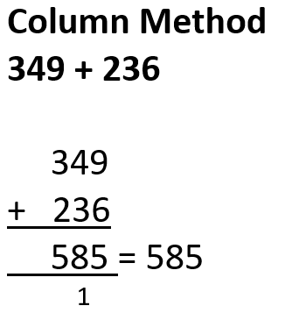
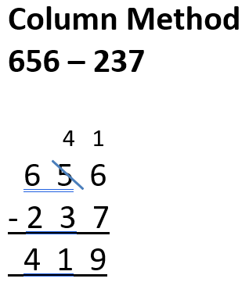
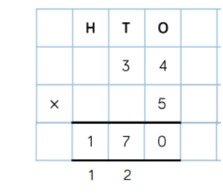
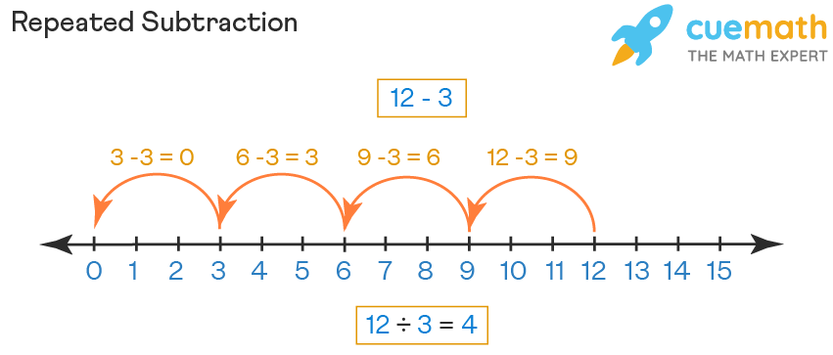
Maths
Methods used for addition, subtraction, multiplication and division Year 3.

Slide 5

Maths
Help your child practise their times tables. Little and often works best.
Encourage your child to use TTRS at home.
Look out for Maths Monkey! He will be coming home for the weekend with each child this year. He has a box full of exciting Maths activities for you and your child to use.
Look out for our helping your child at home with Maths parent workshop later this term.

Slide 6
English
In Year 3, English is delivered through a book centred approach which engages the children in high level texts, stimulates their creative writing ideas and gives a model for spelling, punctuation and grammar.
These texts are: The Enormous Crocodile, Leonora Bolt, Jake Cake and the Werewolf Teacher then Jake Cake and the missing mummy.
Children will be taught how to read fluently and with expression in their fluency lessons and taught the key skills of comprehension.
By the end of Year 3 children are expected to:
Organise their ideas into detailed sentences, ensure their writing is coherent has a clear structure.
Read a variety of texts fluently and with expression.
Read for understanding by retrieving information and begin to use clues in the text to answer questions.
Spell phonetically plausible words and common exception words for Years 1 , 2 and 3.
Use capital letters, full stops, commas in a list, question marks and exclamation marks to demarcate a range of sentences.
Use interesting vocabulary and a variety of conjunctions within their writing.

Slide 7
English
Please help your child at home by asking them to read to you at least four times a week and sign their home school diary so they can achieve their reading certificates.
Share books with them and read books to them – these can be their school reading book, a book from home or the library.
Practise their weekly spellings.

Slide 8
Foundation Curriculum
In Year 3 children will be learning new skills and building knowledge of History, Geography, Science, Art, Music and DT through 6 topics this year.
The topics are:
Time Travellers | The Invisible Force | Beneath our Feet | Green Fingers | Brilliant Bodies | Egyptians
Children also follow a computing curriculum where they learn how to keep themselves safe and a range of computer literacy skills, including typing, copy and paste, searching, saving and opening work; photo editing and animations; coding.
They are also taught about religion in RE, following the Saffron Scheme of work. Children explore religion through different lenses, focusing on theology, philosophy and Human and Social Science. In Year 3, we focus on a wide variety of world religions, including Christianity, Judaism, Sikhism and Islam. This helps the children to develop an understanding of different people in their community.
Children will begin learning French through a range of topics including: greetings, colours, shapes, sizes and numbers. We will also learn about other countries and cultures through our Language of the Month.

Slide 9
Foundation Curriculum
PE will be taught twice a week and children will learn progressive skills through games, dance and gymnastics sessions.
They will need the correct PE kit:
Red shorts
White t-shirt
Trainers
Plain back joggers and jumper (tracksuit) for outdoor PE in colder weather
Our PE days are:
Class 10: Tuesday and Thursday
Class 11: Tuesday and Wednesday
Class 12: Wednesday and Thursday

Slide 10
RSE in Year 3
It is now statutory that all children learn about relationships and sex education and the curriculum has been updated this year. As a school we follow DfE guidance on what should be taught and have planned a curriculum that best fits the needs of the children at each stage of their development.
Through our RSHE curriculum, pupils learn how to recognise safe, respectful and positive relationships, seek help from trusted adults when needed, stay safe online and understand the physical and emotional changes that occur as they grow up.
In Year 3, children will learn about these topics:
Healthy Life Styles (personal hygiene dental health and active lifestyles)
First Aid (shocks and cuts, making emergency calls)
Feeling and Emotions (emotions and why we feel them, managing worries)
Families and Friendships : respectful relationships (showing good manner, kindness and what makes a good friend, respect, bullying, belonging to a community.)
Keeping ourselves safe: sun, road, rail
Making Choices Online (protect information online and make choices about online content, including understanding age ratings)
The Environment (how we can improve the environment canals and rivers, floods)
Money Management (saving money)
Aspirations (growth mindset and knowing our own strengths)
If you would like to discuss any of this content or see any content please talk to the class teacher and visit the website which is being updated this year to show changes to the RSE curriculum.

Slide 11
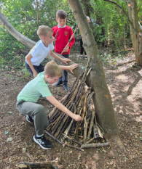
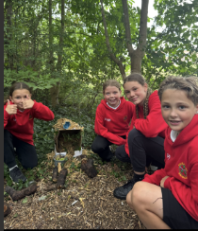
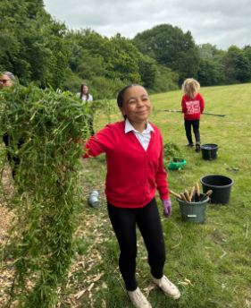
Forest School
This year, Forest School will continue for every year group.
Forest School is the opportunity for children to learn about the outdoors. Learning facts about nature and local wildlife, growing an appreciation for these and engaging in enriching experiences outside of the academic curriculum.
Each year group will have a week of afternoons at Forest School. These sessions will be held in the developed woodland at the bottom of the field.

Slide 12

These sessions will happen rain or shine.
Your child will need:
Forest School
Long trousers (shorts are not allowed)
Closed shoes that can get muddy – old trainers, wellies, walking boots
Top that can get muddy.
Rain coat if it is raining.
Hat if it is sunny.
Please check the forecast in the morning to make sure you send the appropriate clothes in for that day.

Slide 13
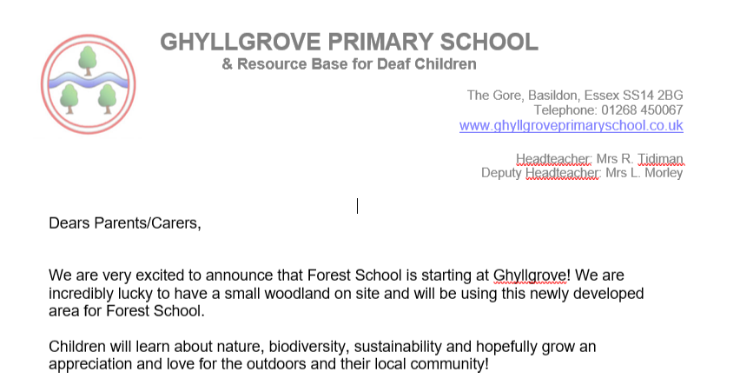
Forest School Times
A letter will be sent out the week before your child’s class attends Forest School. Please ensure your child brings in their forest clothes everyday for their forest school week.
Spring 1 – Year 3

Slide 14
Trips, Workshops and Visitors
Autumn
Stone Age Extravaganza
Chelmsford Museum - £14 coach
Fire Safety Workshop
Library Visit
Spring
Fossils and Volcanoes Workshop
Lucy Brandt – Author Visit
Pizza Express - £3
Summer
Medical Mavericks Workshop
Farm Visit – Coach cost TBC
LEGO Workshop
The cost of all workshops and trips in red is covered by the school.
Please ensure all allergy and medical records are up to date via the office.

Slide 15

Something very exciting!
Growing sessions: Children learn how to sow, transplant and care for a variety of different crops in different situations (raised beds, pots and buckets).
Cooking sessions: Children learn to cook several different dishes and have the opportunity to taste new things using seasonal and local produce.
Farm visit: Children visit a real, working farm and spend some time getting to know the farmer and learning about what a farmer's life is like. We help them to see the connection between the countryside, farming and the food they eat.
Playground market: Children run a mini farmers' market at school for parents. They conduct research to decide what will sell best. Having promoted the market, the children order the produce they wish to sell, weigh it out, price it and sell it!
Local Food Hero session: A local farmer or food producer comes to school to talk about the work they do (and hopefully bring samples to taste and touch!).
Learning journal session: Children reflect on what they have learnt and experienced. They keep journals with photos, notes, pictures and keepsakes.
Harvest Feast: At the end of the year, pupils harvest the fruit and vegetables they have grown and cook them up to share a feast together!

Slide 16

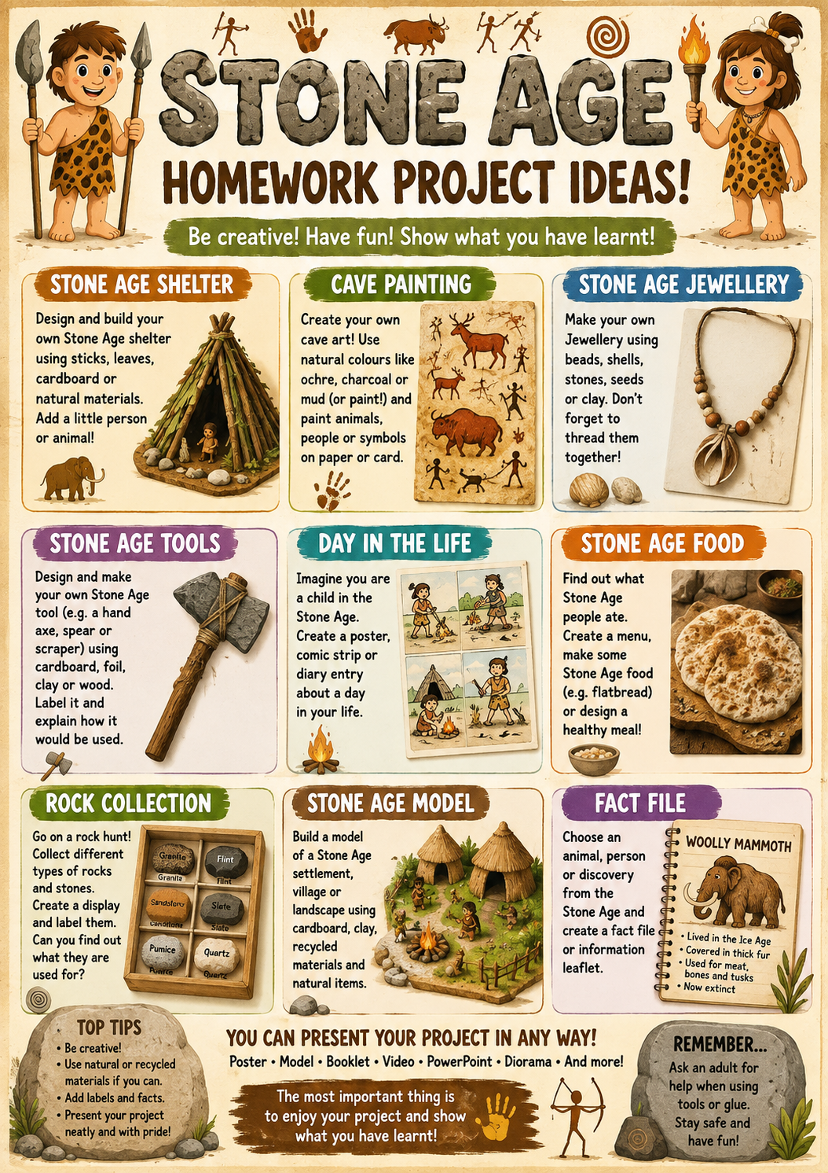
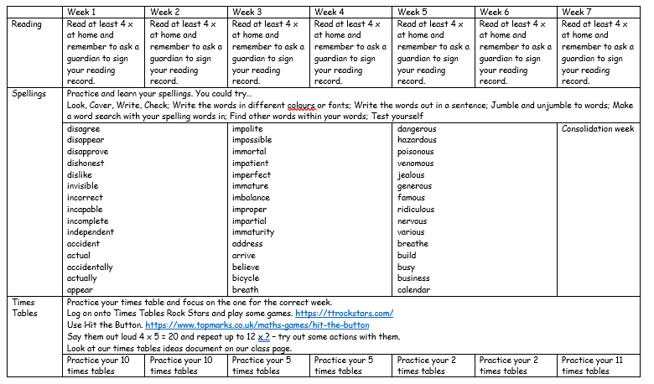
Helping at home…

Slide 17
Behaviour
The school behaviour system is consistent throughout the primary school and you can still expect to see Green Certificates at the end of the week.
In school, children will learn the school rules and learn how to make good, kind and respectful choices. We will strive to show our Ghyllgrove Learning Powers and our School Values. There are many rewards for following school rules and making good choices such as positive praise, stickers, golden time, team tokens, certificates and bronze, silver and gold awards. This year children have the chance to win the Headteachers’ Special Award for outstanding behaviours in school.
There are sanctions when the school rules are not followed and children know what these are. When children lose all three chances in class or break a school rule they can receive a verbal warning and for more serious behaviours a written warning. Please look out and praise your child when they receive a green certificate and a yellow certificate. If they do not bring a certificate home it could be worth checking with the teacher why not if they have not already spoken to you.

Slide 18


School Values
The school environment and school behaviour systems are underpinned by core values and learning styles.
This is the language we will use in promoting the children’s self-esteem, desire to learn and behaviour choices.
These are at the heart of Ghyllgrove, our vision and everyday life in school.

Slide 19


Keeping up to date

Slide 20
If you have any concerns or worries please email or call into the school and we will arrange a time to chat with you. parents@ ghyllgrove.essex.sch.uk

Slide 21
QUESTION TIME!

