Slide 1

Welcome to Year 2
Parent workshop

Slide 2
Aims
Meet the Year 2 Teachers
Know the curriculum your child will be taught this year
School behaviour system
RSE in Year 2
How to support your child at home

Slide 3
English
English is delivered through a variety of text structures e.g stories, poems.
Wherever possible our English is linked to our Topic, we believe this helps to develop creative writing and gives the children’s pieces of work purpose.
Some examples of texts that your children will be looking at this year include Billy’s Bucket and diary entries from the Great Fire of London.
By the end of Year 2 children should be able to:
Be able to read largely fluently.
Write clearly and accurately.
Participate in discussions and answer questions about a piece of text.
Form letters that are of the correct size and begin to develop a joined up handwriting style.
Use correct punctation and write accurately in the future, present and past.
Build their writing stamina so that they can write longer pieces.

Slide 4
Phonics and the Phonics Screening
Phonics is taught daily in Year 2 in sessions that last approximately half an hour.
Children learn a sound a day and focus on a few new Common Exception Words per week.
Currently, we are working towards the Phonics Screening Check that the children missed in Year 1 due to Covid restrictions.
Phonic Screening
It assesses a child’s ability to read words with certain sound patterns.
It asks the children to read real and ‘alien’ words.
If a child ‘fails’ the check it does not mean that their reading is not developing or they cannot move to the next phase of study.
The check is due to be carried out after October half term.

Slide 5
Spelling
After the Phonics Screening, most children will move to learning specific spelling rules rather than a sound.
This helps to further develop their spelling accuracy within their writing and helps your child to continue to become more fluent with their reading.
Learning these spellings will also help the children with their KS1 SATS.
Children will be set weekly spellings to learn.

Slide 6

English
Please help your child at home by asking them to read to you at least three times a week at home and sign their home school diary .
Remember there are lots of excellent books on Bug Club too.
Share books with them and read books to them.
Encourage and support them to complete their weekly homework on Google Classrooms. English homework is set on alternate weeks.
Practise their weekly spellings/sounds.

Slide 7
Maths
5 7
Tens Ones
By the end of Year 2 children should be able to:
Read, write, compare and order numbers up to 100 in digits and words.
Understand place value in 2 digit numbers up to 100.
Recognise numbers represented in different ways.
Count forwards and backwards in steps 2,3 and 5 from 0 and in 1s and 10s from any number.
Add and subtract numbers up to two 2 digit numbers (for example 85-7, 85-50, 85-48).
Understand and use the x and ÷ symbol.
Multiply and divide numbers by 2, 5 and 10.
Find 1/2 , 1/3, 1/4, 2/4, 1/4 of objects, shapes and amounts.
Measure, compare and order length and height (cm/m), weight (g/kg), capacity (ml/l) and temperature.
Know the names of coins and make different amounts of money using them.
Name 2D shapes and know their properties (number of sides, corners and lines of symmetry).
Name 3D shapes and know their properties (number of edges, vertices and faces).
Number bonds / times tables expectation.
Recall all number bonds to 10 and 20.
Recall their 2, 5 and 10 times tables.

Slide 8
Maths
68 + 7 = 75 73 – 6 = 67 This would be solved mentally by putting the first number in your head and counting forwards of backwards in 1s. | 63 + 30 = 93 73 – 40 = 33 This would be solved mentally by putting the first number in your head and counting forwards of backwards in 1s. | 49 + 36 = 85 40 9 + 30 6 80 5 =85 10 | 45 - 26 = 19 40 5 - 20 6 10 9 =19
7 x 2 = 14 We teach children the X means ‘lots of’ so 7x2 is 7 lots of 2. This would be solved mentally by counting in 2s. | 7 x 2 = 14 7 lots of 2 This would be solved mentally by counting in 2s | 12 ÷ 2 = 6
30
1

Slide 9
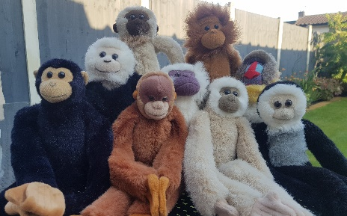
Maths
Encourage and support them to complete their weekly homework on Google Classrooms. Maths homework is set on alternate weeks.
Look out for Marvin the Maths Monkey! He will be coming home for the weekend with each child this year. He has a box full of exciting Maths activities for you and your child to use.
Help your child practise their number bonds (to 10 and 20) and their times tables (2s, 5s and 10s). Little and often works best.
Have a look through our ‘supporting Maths at home’ document for lots more ideas.

Slide 10
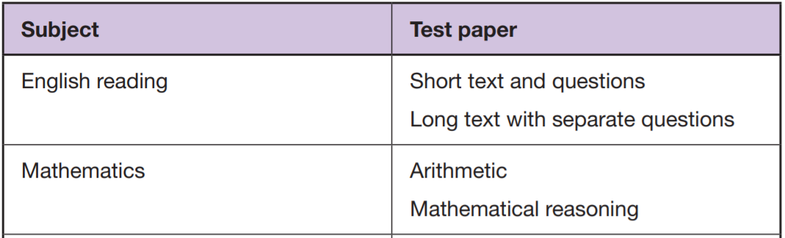
End of KS1 SAT’s
In Year 2, the children will sit National Curriculum tests in Reading and Mathematics, commonly called SATs.
These support us in seeing how your child’s learning in progressing and if and where they may need some additional support in the future.
This year, the test will be taken in May 2022.
Writing is assessed using the written work from the children’s books throughout the year.

Slide 11
Topic: Foundation Curriculum
In Year 2 children will be learning new skills and building knowledge of History, Geography, Science, Art, Music and DT through 6 topics this year.
The topics are:
Oh we do like to be beside the seaside! | Revolting London (The Plague, Great Fire of London) | Amazing Africa | The Victorians | Animal Carnival | Down on the farm
Children also follow a computing curriculum where they learn to be safe online and develop their computer literacy skills. This includes making simple graphics and typing with accuracy.
They are also taught about religion through RE which follows the Discovery Scheme of work and in Year 2 we will be focusing on the world’s main religions e.g. Islam, Judaism. This helps the children to develop an understanding of different people in their community.
PE will be taught twice a week and children will learn progressive skills through games, dance and gymnastics sessions. They will need the correct PE kit of red shorts, a white t-shirt, socks and trainers for indoors and a plain back joggers and jumper (tracksuit) and trainers for outdoor PE .

Slide 12
RSE in Year 2
It is now statutory that all children learn about relationships and sex education.
As a school we follow DfE guidance on what should be taught and have planned a curriculum that best fits the needs of the children at each stage of their development.
In Year 2, children will learn about these topics:
Healthy Life Styles (personal hygiene and active lifestyles)
Growing, Changing and Reproducing (body part, that growing takes times, how we change as we grow)
First Aid (bites and strings)
Feeling and Emotions (understanding emotions and why we feel them)
Families and Friendships (showing good manner, kindness and what makes a good friend)
Respectful relationships (respect, bullying)
Living with others (team work and group work)
The Environment (how we can improve the environment)
Money Management (saving money)
Aspirations (growth mindset and knowing our own strengths)

Slide 13
Behaviour: School rules, rewards & sanctions, 7 daily habits
The school behaviour system is consistent throughout the primary school and you can still expect to see Green Certificates at the end of the week.
In school, children will learn the school rules and learn how to make good, kind and respectful choices. There are many rewards for following school rules and making good choices such as positive praise, stickers, golden time, team tokens, certificates and bronze, silver and gold awards. This year children have the chance to win the Headteachers’ Special Award for outstanding behaviours in school.
There are sanctions when the school rules are not followed and children know what these are. When children lose all three chances in class or break a school rule they can receive an amber and for more serious behaviours a Red. Please look out and praise your child when they receive a green certificate and a yellow certificate. If they do not bring a certificate home it could be worth checking with the teacher why not if they have not already spoken to you.

Slide 14
Helping us to help you and your children.
Please ensure all school uniform and PE kit is correctly labelled with your child’s name.
On PE days long hair needs to be tied back and earrings removed.
Please inform the school if your child has any dietary requirements or allergies.
If somebody new is picking up your child please inform the office. If it is a regular pick up, the arrangement can be added to your child’s record.
If your child receives medication in school please return their new care plan and check their medicine is in date.
Occasionally we do get nits in school, please comb your child’s hair regularly to prevent outbreaks in school.
Read at home and complete set homework. Please let us know if your child is struggling with the work at home.

Slide 15
If you have any concerns or worries please email or call into the school and we will arrange a time to chat with you. parents@ghyllgrove.essex.sch.uk

