Slide 1

Welcome to Year 1
Parent workshop

Slide 2
Aims:
Meet the Year 1Teachers
Know the curriculum your child will be taught this year
School behaviour system
RSE in Year 1
How to support your child at home

Slide 3
Maths
In maths, some of the main skills we expect children to be able to do by the end of the year are; count to 100 forwards and backwards from any given number, read and write numbers to 20 in numerals and words, count in multiples of 2, 5 and 10, finding 1 more and 1 less of any number within 100, read write and interpret mathematical statements using + - and =, add and subtract numbers within 20.
Number bonds are very useful to help with many different areas of maths so in year 1, children need to know are all of their bonds from 0 to 20.
Ways to help at home would be to practise counting to 100 forwards and backwards from any number. A Maths Monkey will go home with a child once a week for the weekend.

Slide 4
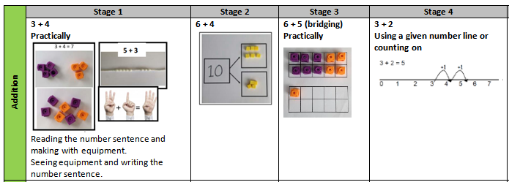
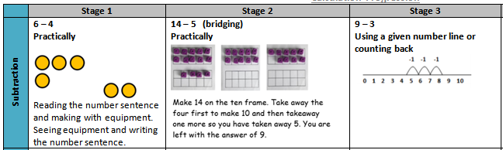
Maths
Examples of Addition, subtraction

Slide 5
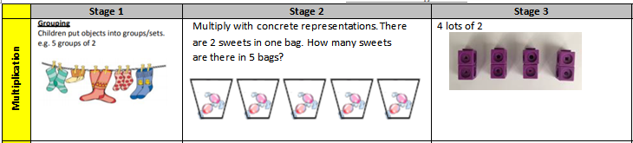
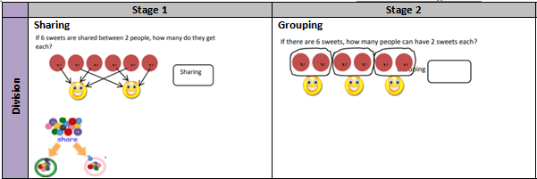

Slide 6



English
In year 1 English is delivered through a range of teaching styles and at times a book centred approach which helps the children engage in high level texts to inspire and develop a love for reading.
In Year 1 we use a range of texts to stimulate ideas and provide high level models. Some examples of these texts are,
By the end of Year 1 children are expected to be able to use full stops, capital letters and finger spaces confidently and consistently, write a sequence of sentences to form a short narrative and non-narrative text, read and spell all year 1 common exception words, respond to the 40+ phonemes and graphemes, accurately blend when reading and answer questions about what they are reading.

Slide 7
Phonics and the Phonics Screening
Children will be taught phonics daily, this is a progressive reading scheme that teaches the children to read.
Every day we recap, embed and learn new sounds. When reading we using ‘segmenting’ to work out the word and ‘blending’ to bring the sounds back together to help read the word. The books that are allocated to your child on Bug Club all feature the sounds that they are currently learning and have learnt already. When reading children will encounter common exception words which are not all decodable by using ‘segmenting and blending’, so we have to learn these by sight. These words are learnt in chunks and can be found on the planet stickers in the home school diary.
In year 1, children will sit a formal phonics screening test around June, this is made up of 40 words they have to read using the sounds from phases 2-5 that they have learnt throughout the year. There will be more information about this later in the year.

Slide 8
Reading and English at home
Please help your child at home by asking them to read to you at least three times a week at home and sign their home school diary.
The expectation for reading at home is that your child reads a few pages to you, a minimum of three times a week, we count how many times you have read at home (this does not include multiple books or times read in one day, as we want reading spread over the week for a ‘drip feeding’ approach).
Reading is made up of a few individual skills that all need to be developed for children to become well rounded readers, the application of their phonics and word recognition, fluency and comprehension.
Certificates will be awarded weekly for those reading three times in the week and when they reach a milestone of 25, 50,75 etc. They will earn a large certificate that is awarded in assembly.
It is important to share books with the children, read books to them and listen to them read as it promotes a love for reading that will help them in their education journey.
Encourage and support them to complete their weekly homework on Google Classrooms and practise their weekly spellings.

Slide 9
Topic – Foundation Curriculum
In year 1 children will be learning new skills and building knowledge of history, geography, science, art, music and DT through 6 topics this year.
The topics are:
All Aboard | Whatever The Weather | Where We Live | Ghyllgrove Gardeners | Wonderful World | Toy Museum
Children also follow a computing curriculum where they learn about E-Saftey and a variety of computer based programmes such as paint.
They are also taught about religion through RE which follows the Discovery Scheme of work and in year 1 we learn more about Christianity and Judaism.
PE will be taught twice a week and children will learn progressive skills through games, dance and gymnastics sessions. They will need the correct PE kit of red shorts and a white t-shirt and trainers for indoors and a plain back joggers and jumper (tracksuit) and trainers for outdoor PE.

Slide 10
RSE in Year 1
It is now statutory that all children learn about relationships and sex education.
As a school we follow Dfe guidance on what should be taught and have planned a curriculum that best fits the needs of the children at each stage of their development.
In year 1 it is very much built around friendships.
In year 1 children will learn life skills such as; personal hygiene and sun safety. Recognising the human life cycle, simple home safety, recognise and talk about their different emotions, the importance of families and how to ask for help, good manners, how our behaviours affect the environment and personal aspirations.

Slide 11
Behaviour school rules rewards & sanctions
7 daily habits
The school behaviour system is consistent throughout the primary school and you can still expect to see Green Certificates at the end of the week.
In school children will learn the school rules and learn how to make good, kind and respectful choices. There are many rewards for following school rules and making good choices such as positive praise, stickers, golden time, team tokens, certificates and bronze, silver and gold awards. This year children have the chance to win the Headteachers Special Award for outstanding behaviours in school.
There are sanctions when the school rules are not followed and children know what these are. When children lose all three chances in class or break a school rule they can receive an amber and for more serious behaviours a Red. Please look out and praise your child when they receive a green certificate and a yellow certificate. If they do not bring a certificate home it could be worth checking with the teacher why not if they have not already spoken to you.

Slide 12
If you have any concerns or worries please email or call into the school and we will arrange a time to chat with you.

