Slide 1

Mathematics at ghyllgrove
Years 5 and 6
Mr Dale Collins
Year 2 Teacher
Key Stage 1 Lead
Mathematics Lead
Notes:
dcollins teacher

Slide 2
Today’s aims…
Give you an overview of the Year 5 and 6 curriculum for Maths.
Look at how calculation is taught in Year 5 and 6.
Ideas for supporting Maths at home.
Update on E-Safety

Slide 3
What do we want for the children at ghyllgrove?
Confidence
Fluency
Strong arithmetic skills
Skills for Life
Enjoyment of the Subject
Having fun

Slide 4

Maths
Fractions, algebra, etc
Written and mental methods for + - x /
Mathematical Language
Counting
Number Bonds
Number Facts
Times Tables

Slide 5
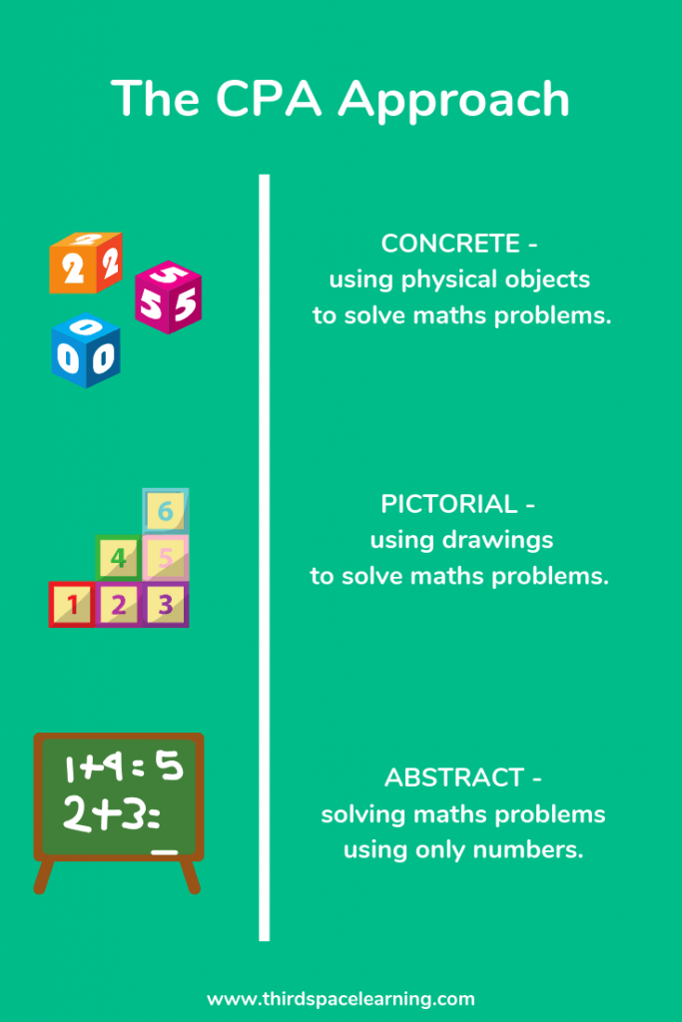

Slide 6
Addition and Subtraction
By the end of Year 5
By the End of Year 6
Add and subtract whole numbers with more than 4 digits, including using formal written methods (columnar addition and subtraction)
Add and subtract numbers mentally with increasingly large numbers
Use rounding to check answers to calculations and determine, in the context of a problem, levels of accuracy
Solve addition and subtraction multi-step problems in contexts, deciding which operations and methods to use and why.
Perform mental calculations, including with mixed operations and large numbers
Solve addition and subtraction multi-step problems in contexts, deciding which operations and methods to use and why
Solve problems involving addition, subtraction, multiplication and division.

Slide 7
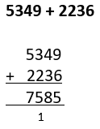
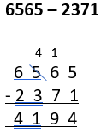
Year 5 AND 6 – SHORT / COLUMN mETHODS
With increasing larger numbers and decimals.

Slide 8
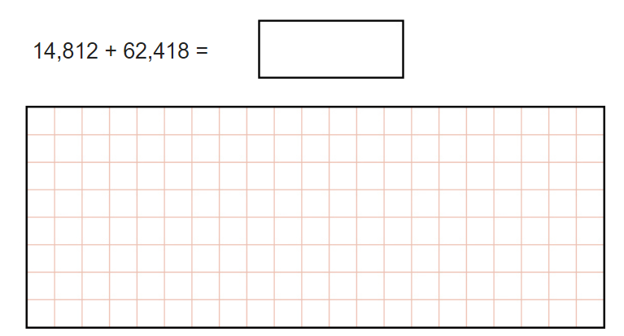
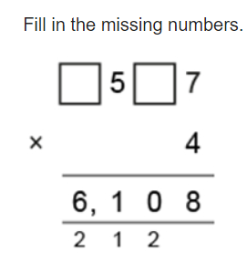

Slide 9
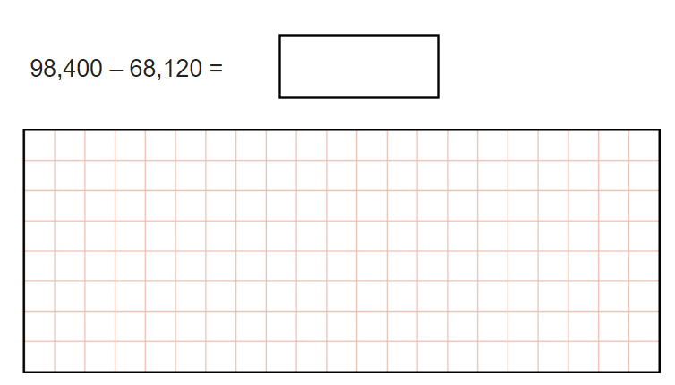

Slide 10
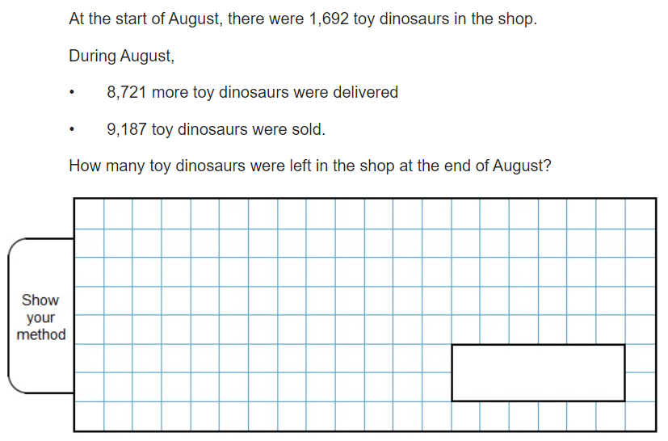

Slide 11
Multiplication and Division
By the end of Year 5
By the End of Year 6
Multiply numbers up to 4 digits by a one- or two-digit number using a formal written method.
Divide numbers up to 4 digits by a one-digit number using the formal written method of short division and interpret remainders appropriately for the context
Multiply and divide whole numbers and those involving decimals by 10, 100 and 1000
Recognise and use square numbers and cube numbers, and the notation for squared (2) and cubed (3)
Solve problems involving addition, subtraction, multiplication and division and a combination of these.
Multiply multi-digit numbers up to 4 digits by a two-digit whole number using the formal written method of long multiplication.
Divide numbers up to 4 digits by a two-digit number using the formal written method of short division where appropriate, interpreting remainders according to the context
Perform mental calculations, including with mixed operations and large numbers
Solve problems involving addition, subtraction, multiplication and division.

Slide 12
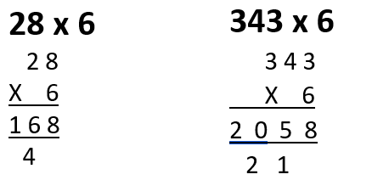
Year 5 AND 6 – Short multiplication
With increasing larger numbers (up to 4 digits) and decimals.

Slide 13
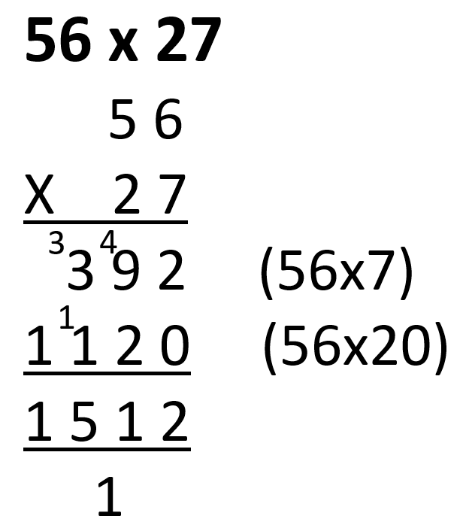
Year 5 and 6 – Long multiplication
With increasing larger numbers (up to 4 digits) and decimals.

Slide 14
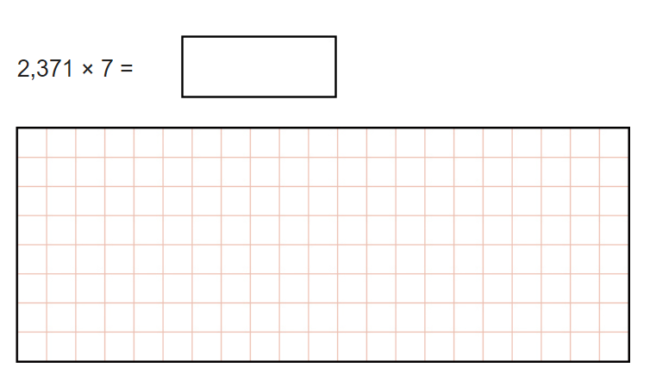

Slide 15
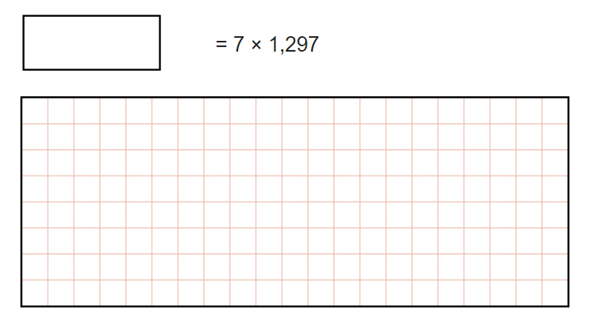

Slide 16
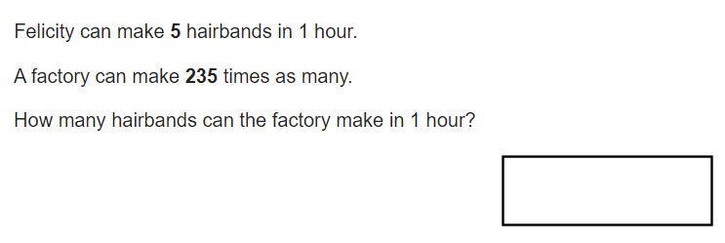

Slide 17
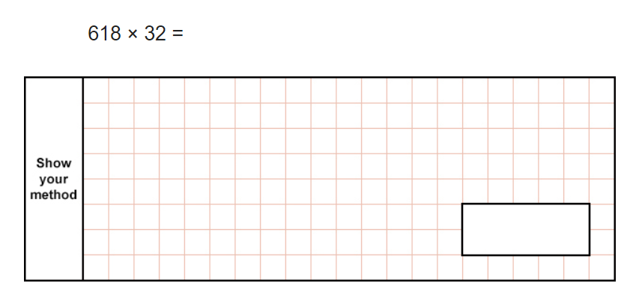

Slide 18
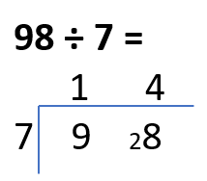
Year 5 and 6 – bus stop
With increasing larger numbers (up to 4 digits) and decimals.

Slide 19
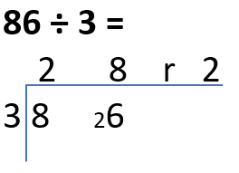
Year 5 and 6 – Bus stop
With increasing larger numbers (up to 4 digits) and decimals.

Slide 20
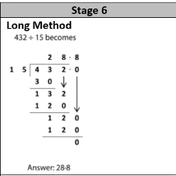
Year 6 – Long division

Slide 21
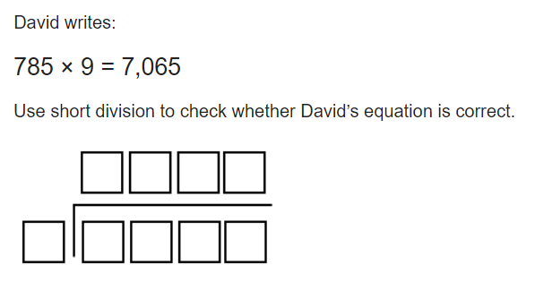

Slide 22
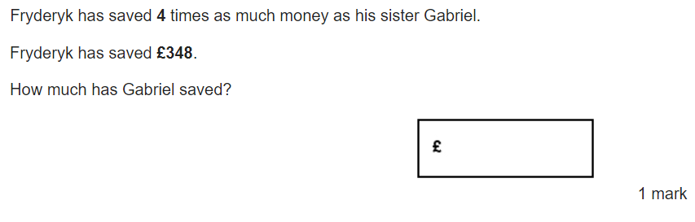

Slide 23
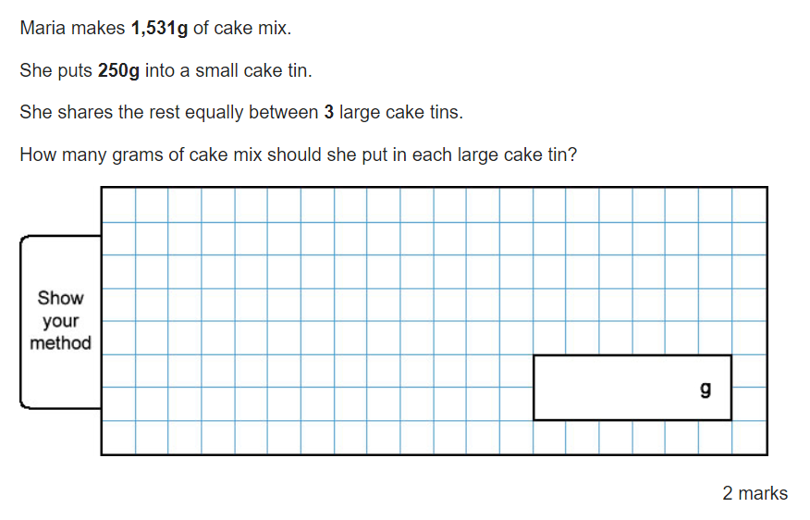

Slide 24
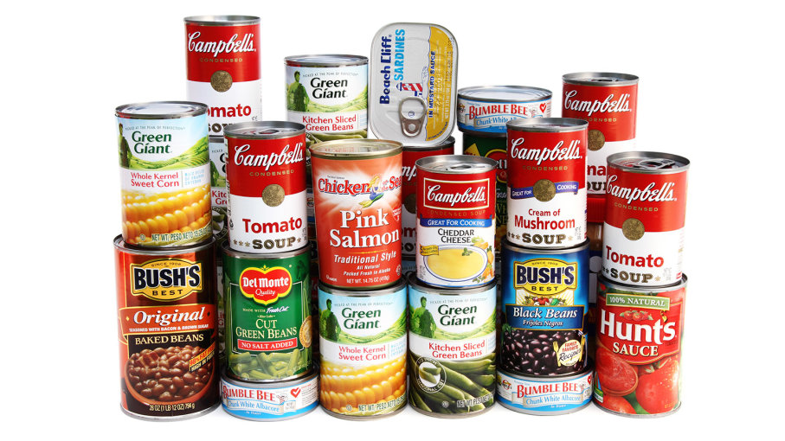


Slide 25
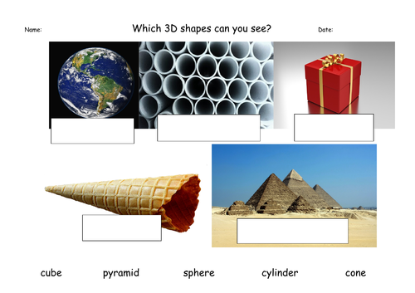

Slide 26
BUILDING SOLID FOUNDATIONS
Baking at home
Handling money
Identify coins.
Buy items and add the prices.
Work out the change.

Slide 27
BUILDING SOLID FOUNDATIONS
Measure
Measure items
TV guides – length of your favourite programmes

Slide 28
BUILDING SOLID FOUNDATIONS
Counting
Everyday objects at home
Board games
Thermometers

Slide 29
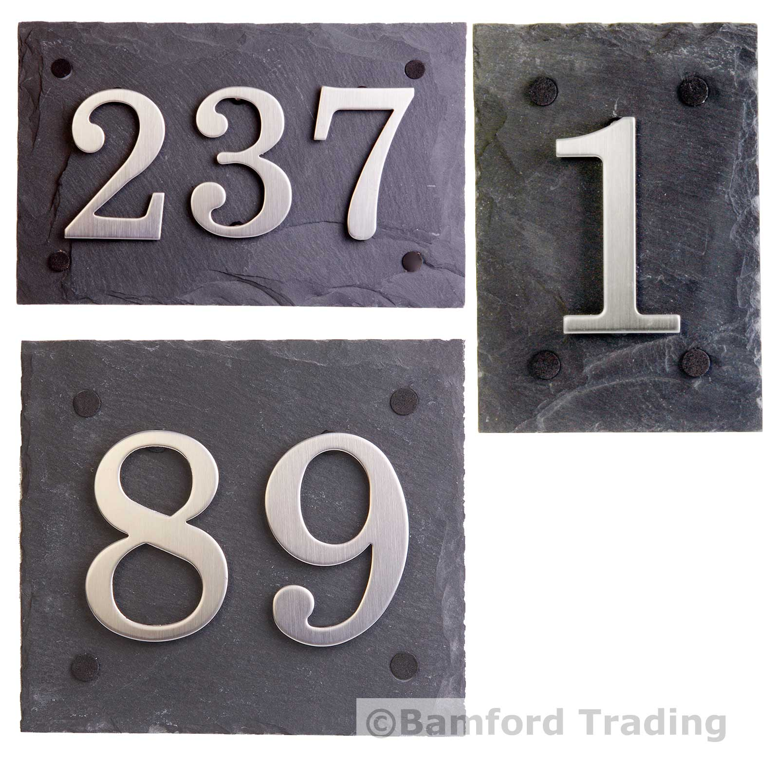
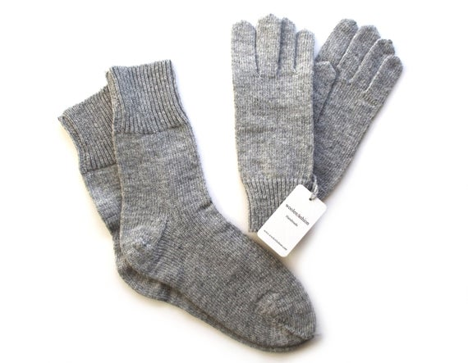
Use anything and everything

Slide 30
BUILDING SOLID FOUNDATIONS
Number Facts
Random quick fire questions
Rock, paper, scissors
Dice, playing card, dominoes

Slide 31
BUILDING SOLID FOUNDATIONS
Times Tables
Pupils at Ghyllgrove are expected to learn their times tables and division facts off by heart
X 12 by end of Year 4
They will be tested at the end of Year 4.

Slide 32

BUILDING SOLID FOUNDATIONS
Times Tables
Regular practise in school and at home.
Dice, playing cards, dominoes.
Ping Pong.
Rock, Paper, Scissors.
Beat Siri or Alexa

Slide 33

BUILDING SOLID FOUNDATIONS
Times Tables Rock Stars

Slide 34
ALWAYS HERE TO HELP.
Thank you for your time this morning

