Slide 1

Mathematics at ghyllgrove
Years 3 and 4
Mr Dale Collins
Year 2 Teacher
Key Stage 1 Lead
Mathematics Lead
Notes:
dcollins teacher

Slide 2
Today’s aims…
Give you an overview of the Year 3 and 4 curriculum for Maths.
Look at how calculation is taught in Year 3 and 4.
Ideas for supporting Maths at home.
Update on E-Safety

Slide 3
What do we want for the children at ghyllgrove?
Confidence
Fluency
Strong arithmetic skills
Skills for Life
Enjoyment of the Subject
Having fun

Slide 4

Maths
Fractions, algebra, etc
Written and mental methods for + - x /
Mathematical Language
Counting
Number Bonds
Number Facts
Times Tables

Slide 5
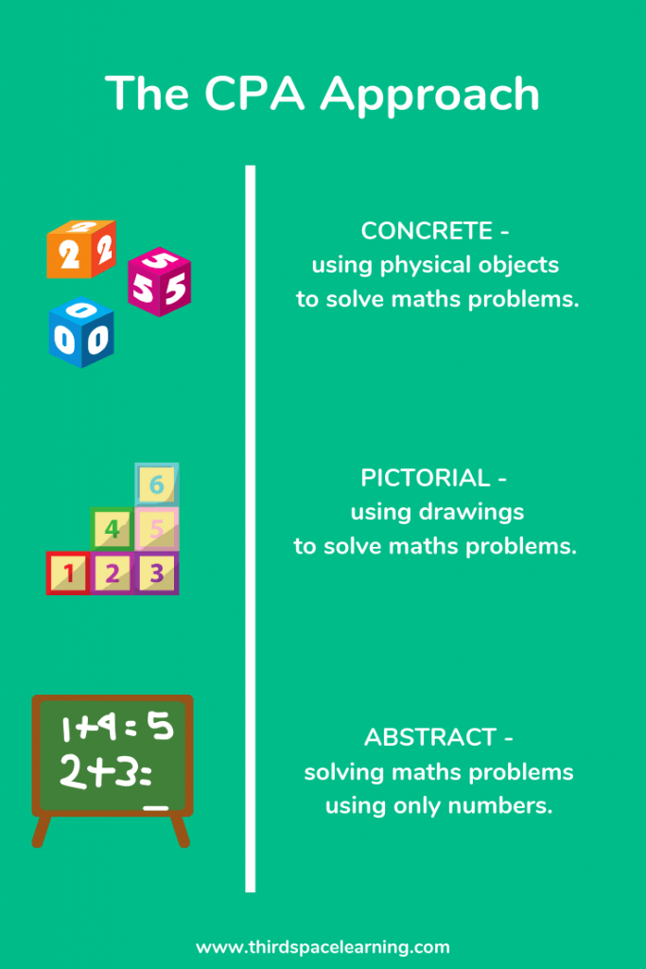

Slide 6
Addition and Subtraction
By the end of Year 3
By the End of Year 4
Add and subtract numbers mentally, including:
- a three-digit number and ones
- a three-digit number and tens
- a three-digit number and hundreds
Add and subtract numbers with up to three digits, using formal written methods of columnar addition and subtraction.
Solve problems, including missing number problems, using number facts, place value, and more complex addition and subtraction.
Add and subtract numbers with up to 4 digits using the formal written methods of columnar addition and subtraction where appropriate.
Solve addition and subtraction two-step problems in contexts, deciding which operations and methods to use and why.

Slide 7
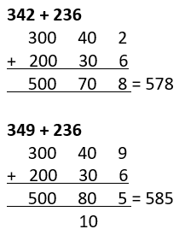
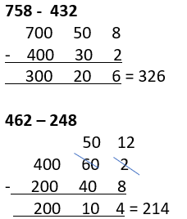
Year 3 – Expanded methods

Slide 8
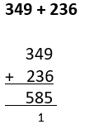
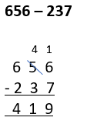
Year 3 – Short / column methods

Slide 9
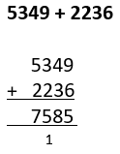
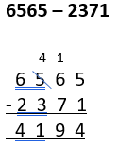
Year 4 – short / column methods

Slide 10
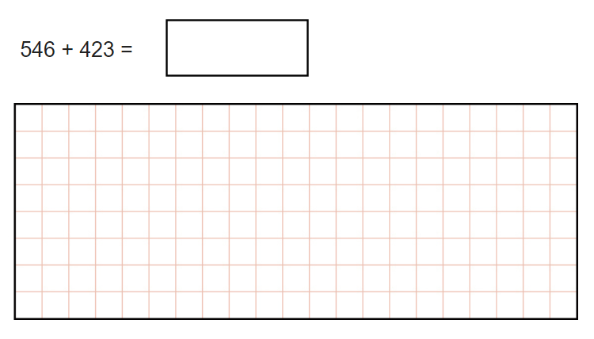

Slide 11
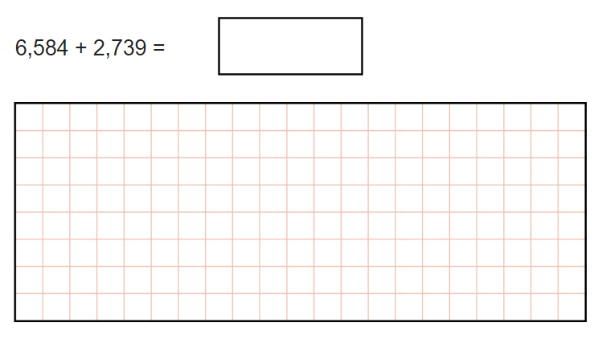

Slide 12
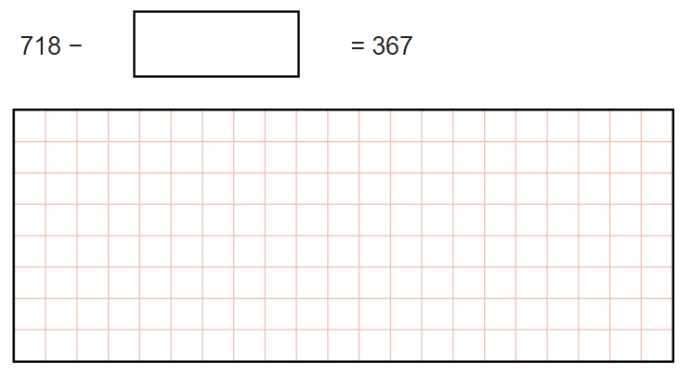

Slide 13
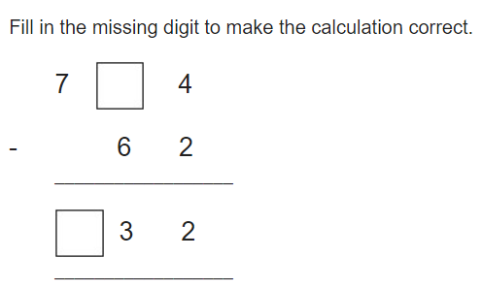

Slide 14
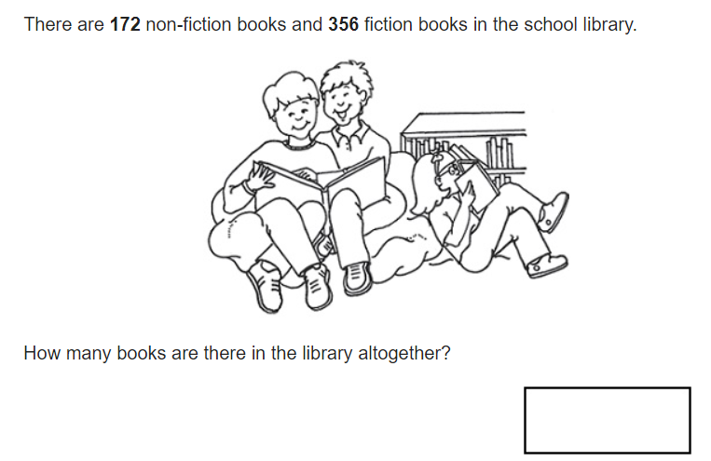

Slide 15
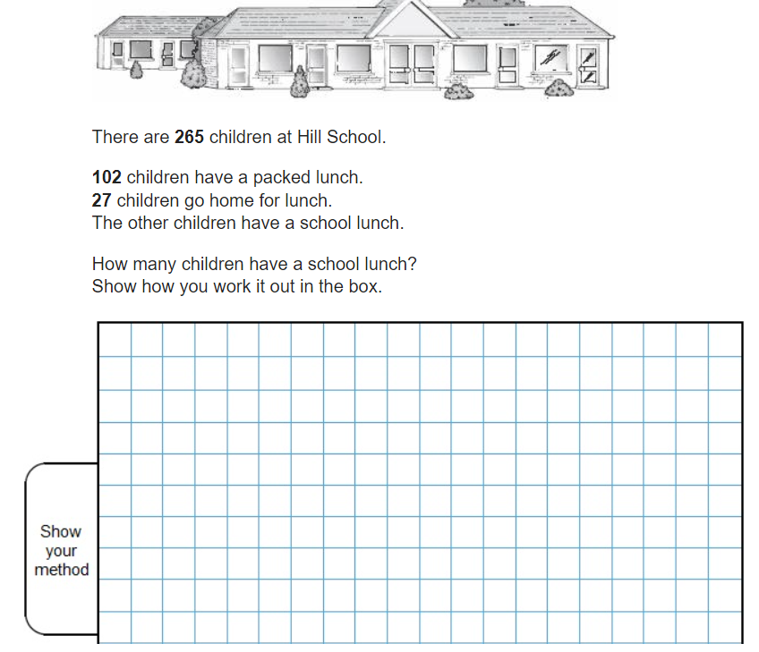

Slide 16
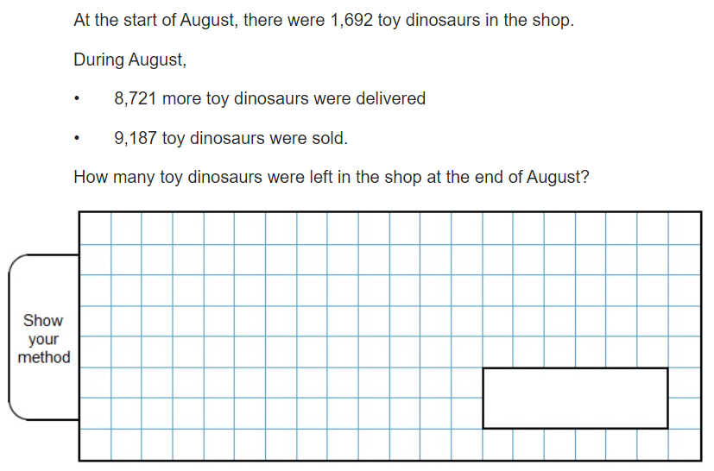

Slide 17
Multiplication and Division
By the end of Year 3
By the End of Year 4
Recall and use multiplication and division facts for the 3, 4 and 8 multiplication tables.
Write and calculate mathematical statements for multiplication and division using the multiplication tables that they know, including for two-digit numbers times one-digit numbers, using mental and progressing to formal written methods.
Solve problems, including missing number problems, involving multiplication and division.
Recall multiplication and division facts for multiplication tables up to 12 × 12.
Use place value, known and derived facts to multiply and divide mentally, including: multiplying by 0 and 1; dividing by 1; multiplying together three numbers.
Multiply two-digit and three-digit numbers by a one-digit number using formal written layout.
Solve problems involving multiplying and adding.

Slide 18
Year 3 and 4 – repeated addition
When solving calculations within their times table knowledge, children will used repeated addition.
4 x 4 = 16

Slide 19
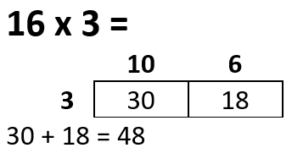
Year 3 – GRID METHOD

Slide 20
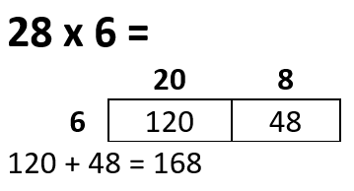
Year 4 – GRID METHOD

Slide 21
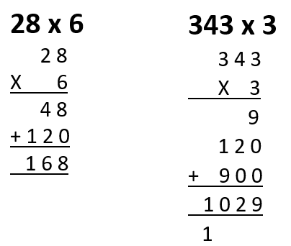
Year 4 – LADDER METHOD

Slide 22
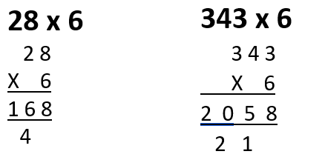
Year 4 – SHORT MULTIPLICATION

Slide 23
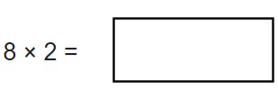
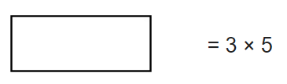


Slide 24
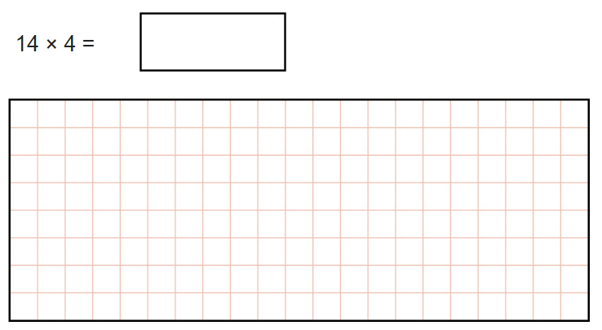

Slide 25
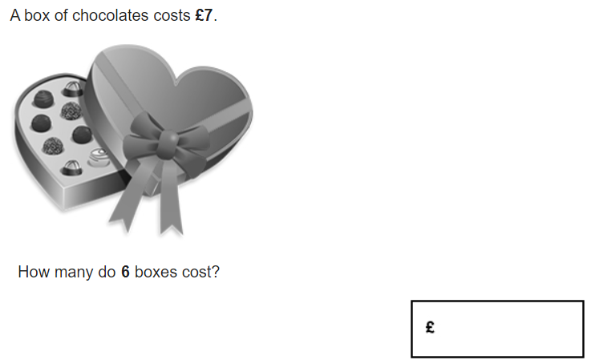

Slide 26
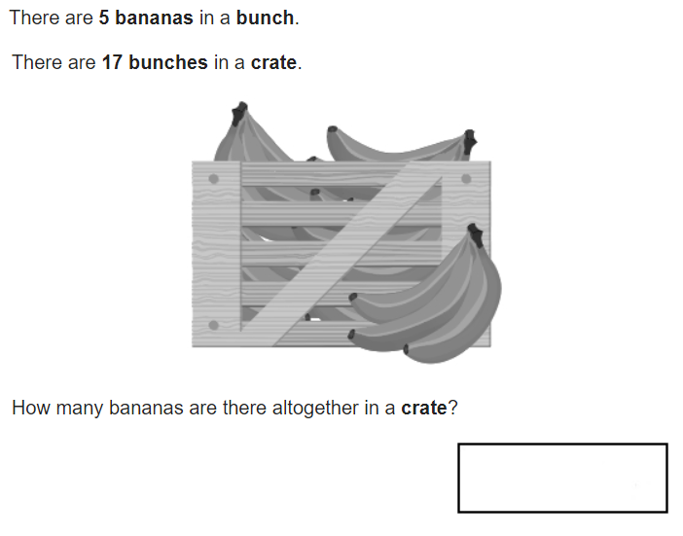

Slide 27
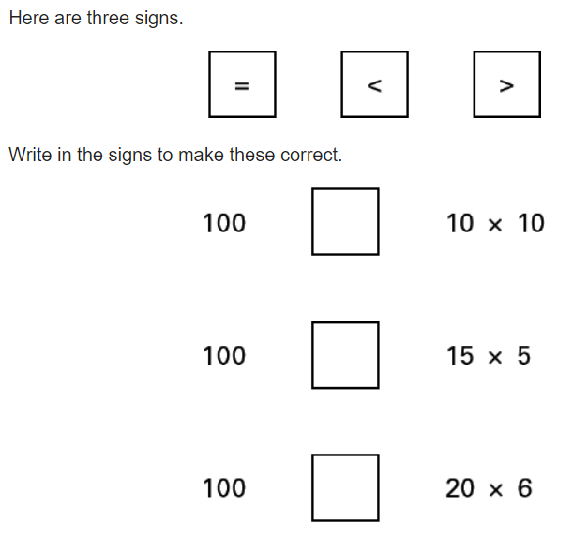

Slide 28
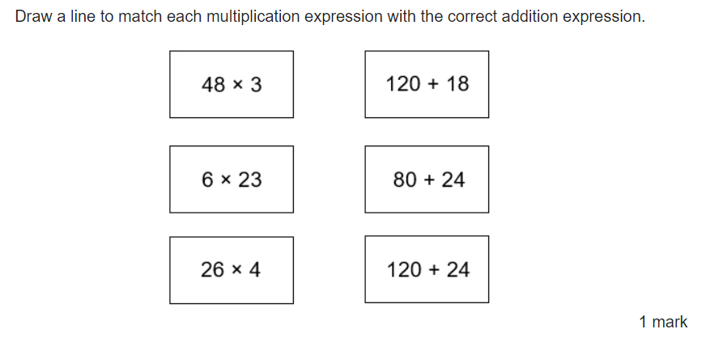

Slide 29
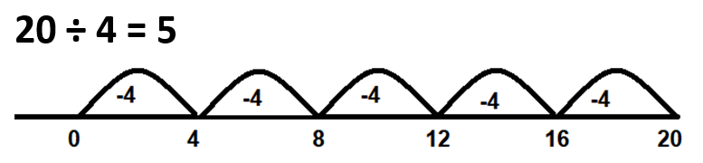
Year 3 AND 4 – REPEATED SUBTRACTION
When solving calculations within their times table knowledge, children will used repeated subtraction.

Slide 30
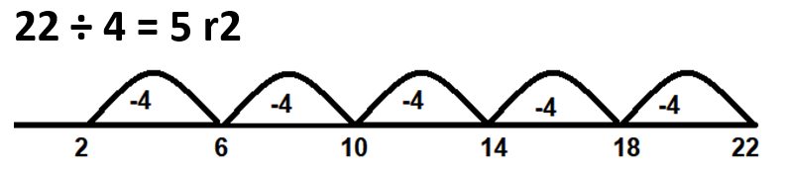
Year 3 AND 4 – REPEATED SUBTRACTION
When solving calculations within their times table knowledge, children will used repeated subtraction.

Slide 31
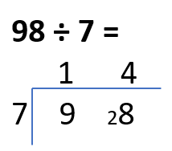
Year 4 – Bus stop

Slide 32
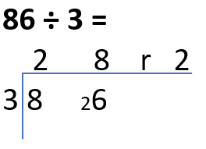
Year 4 – bus stop

Slide 33


Slide 34
83 ÷6

Slide 35
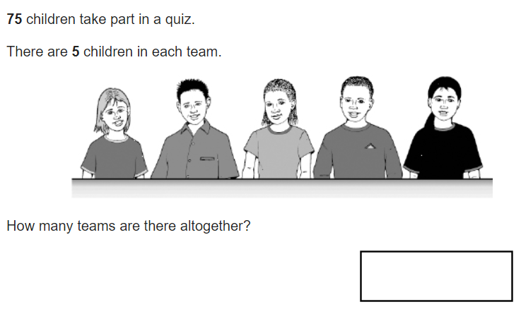

Slide 36
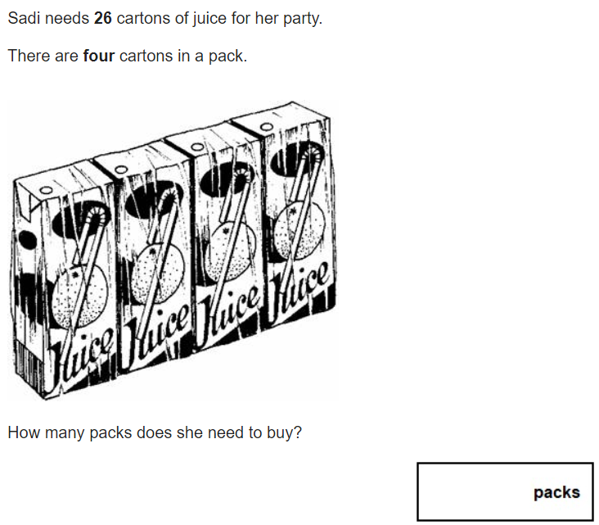

Slide 37



Slide 38
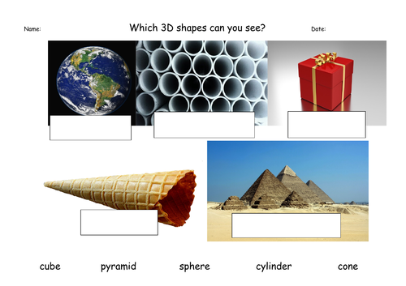

Slide 39
BUILDING SOLID FOUNDATIONS
Baking at home
Handling money
Identify coins.
Buy items and add the prices.
Work out the change.

Slide 40
BUILDING SOLID FOUNDATIONS
Measure
Measure items
TV guides – length of your favourite programmes

Slide 41
BUILDING SOLID FOUNDATIONS
Counting
Everyday objects at home
Board games
Thermometers

Slide 42
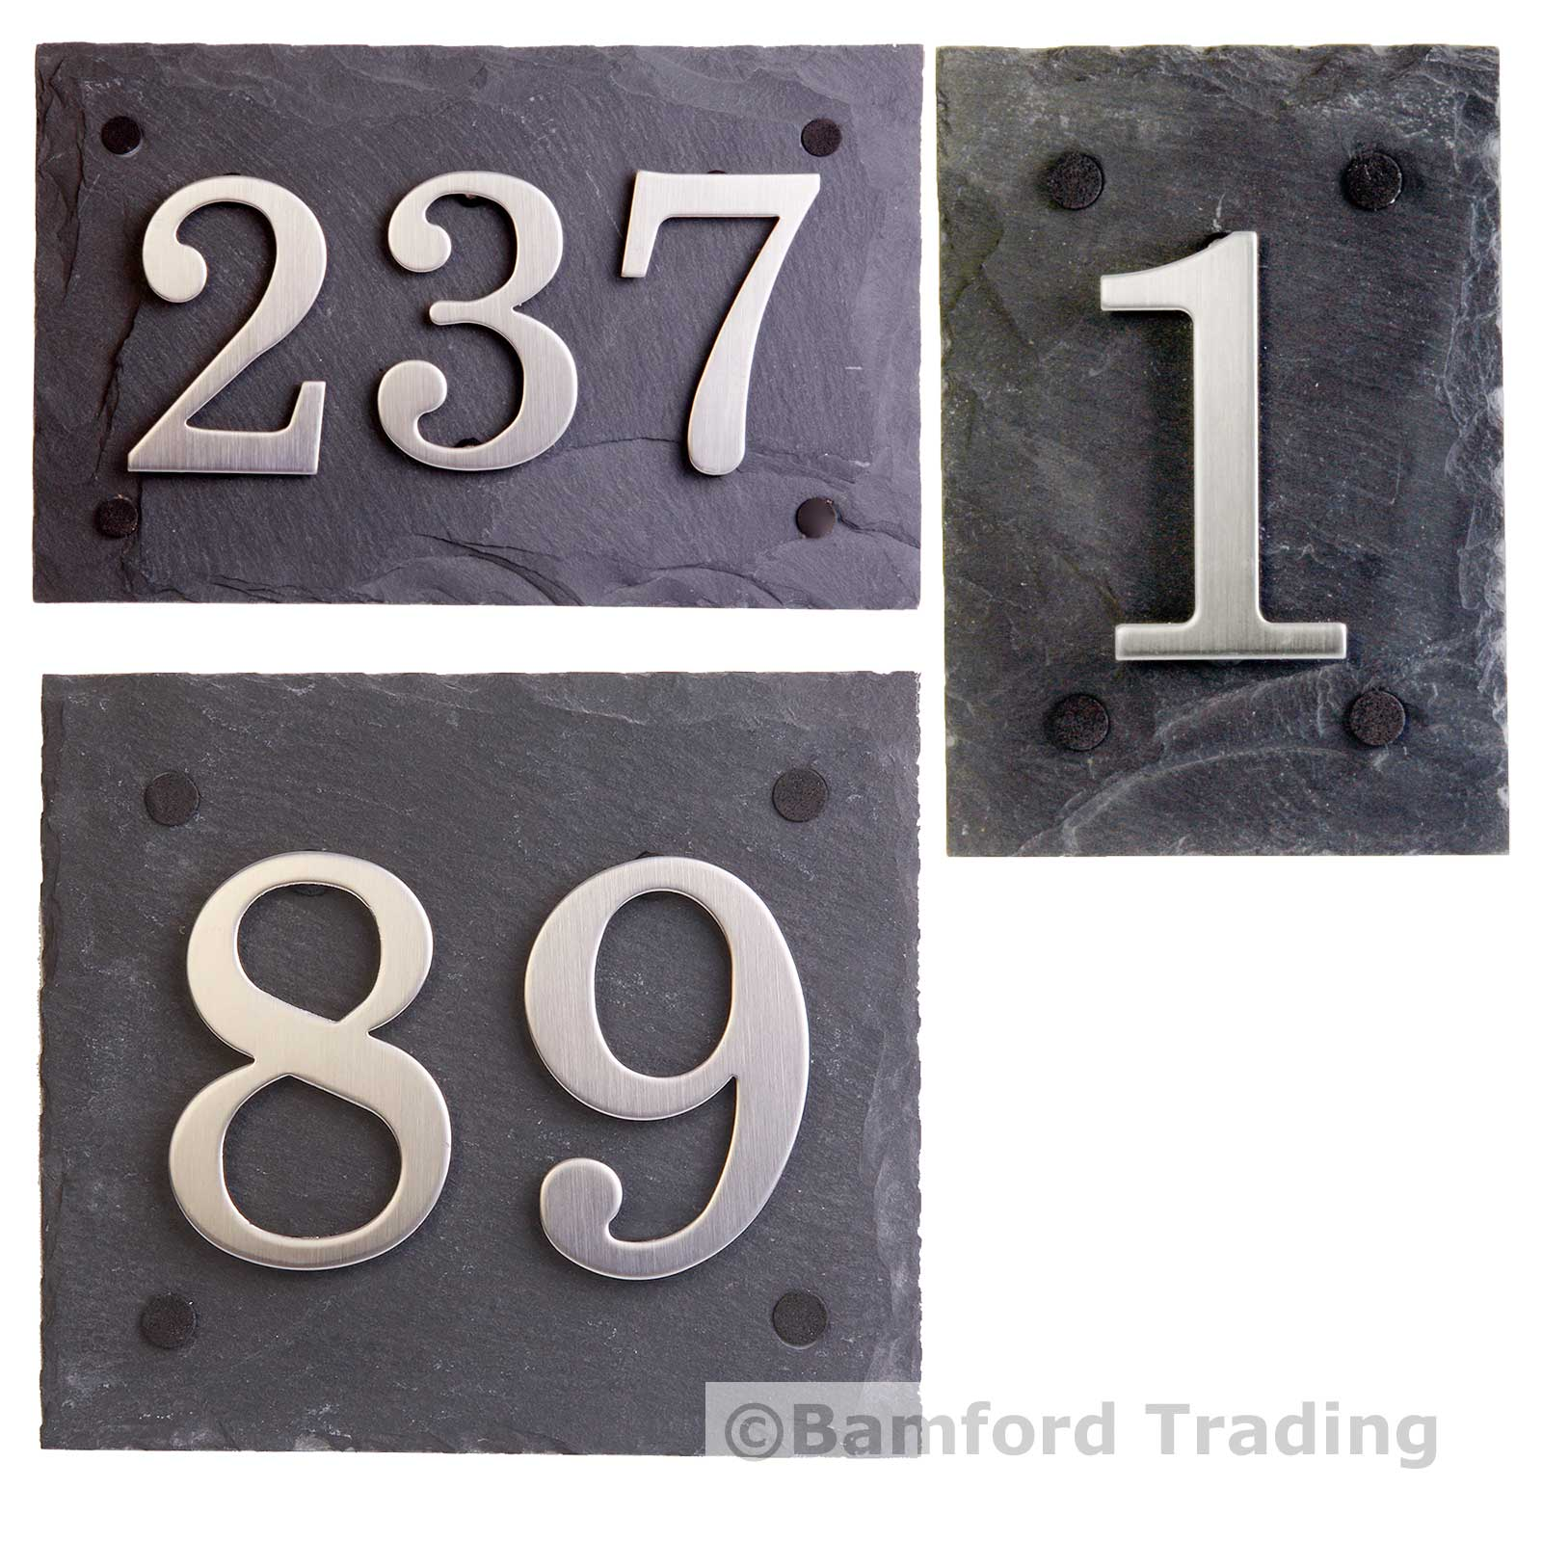
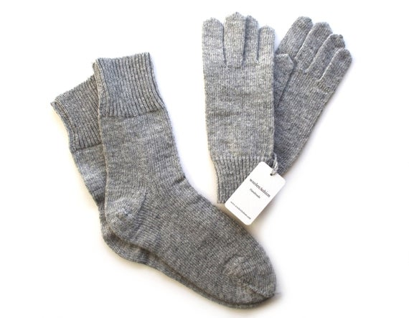
Use anything and everything

Slide 43
BUILDING SOLID FOUNDATIONS
Number Facts
Random quick fire questions
Rock, paper, scissors
Dice, playing card, dominoes

Slide 44
BUILDING SOLID FOUNDATIONS
Times Tables
Pupils at Ghyllgrove are expected to learn their times tables and division facts off by heart
X 12 by end of Year 4
They will be tested at the end of Year 4.

Slide 45

BUILDING SOLID FOUNDATIONS
Times Tables
Regular practise in school and at home.
Dice, playing cards, dominoes.
Ping Pong.
Rock, Paper, Scissors.
Beat Siri or Alexa

Slide 46

BUILDING SOLID FOUNDATIONS
Times Tables Rock Stars

Slide 47
ALWAYS HERE TO HELP.
Thank you for your time this morning

