Slide 1
Year 1 Phonic Workshop
Monday 17th March 2025

Slide 2
RWI Phonics
At Ghyllgrove Primary we follow Read, Write Inc Phonics.
The children in Year 1 have had these sessions since they started in Reception.
Read, Write Inc is a phonic scheme which follows the children from EYFS to Year 2.

Slide 3
Set 1 Sounds – These are the first set of sounds your child has been taught.
Within Set 1 are the first set of “Special Friends”

Slide 4
Set 2 Sounds – At the start of Year 1 the majority of children will be introduced to these sounds.

Slide 5
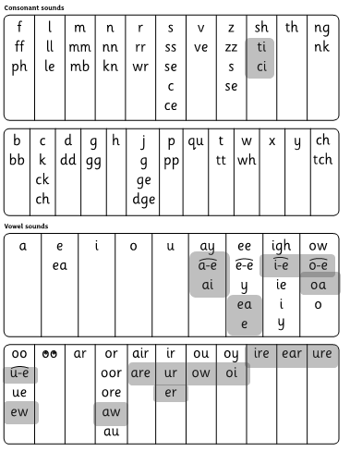
Set 3 Sounds - Once children know how to read Set 2 sounds, they start to learn Set 3 sounds.
These are shaded in the chart.
They are alternative graphemes
(spelling of a sound) for the Set 1 and Set 2 sounds the children already know.

Slide 6
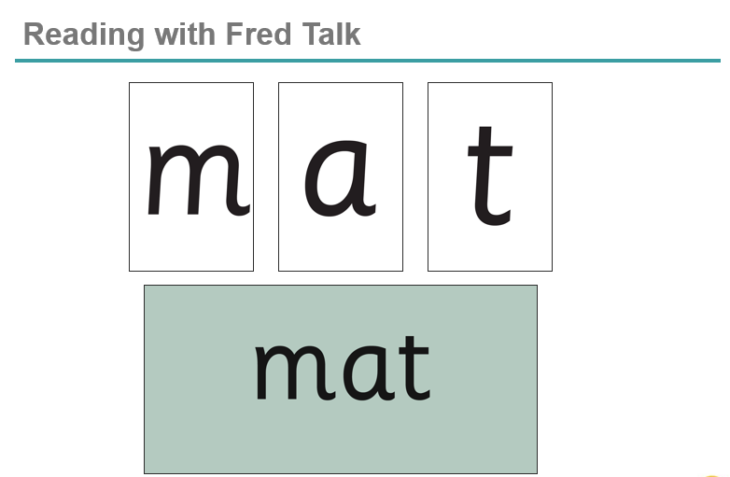
We teach children to read words using Fred Talk to blend together the sounds they know e.g. m-a-t, mat.
We say ‘Fred Talk, read the word’.

Slide 7
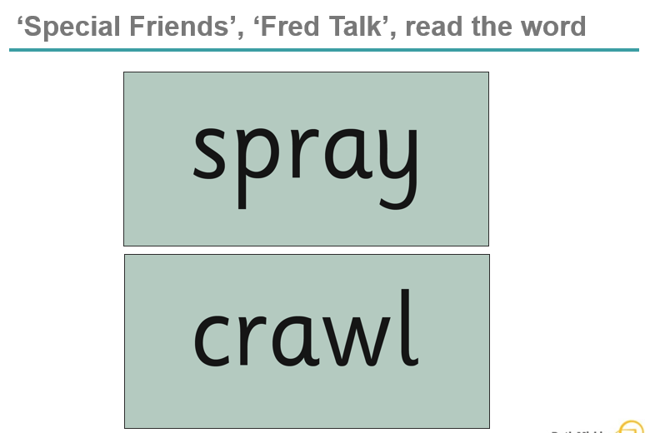
Then children practise reading these sounds in words using the routine ‘Special Friends’, ‘Fred Talk’, read the word’.
They spot the ‘Special Friends’ first, then Fred Talk to read the word.
For example, ‘ay’, s-p-r-ay, spray.

Slide 8
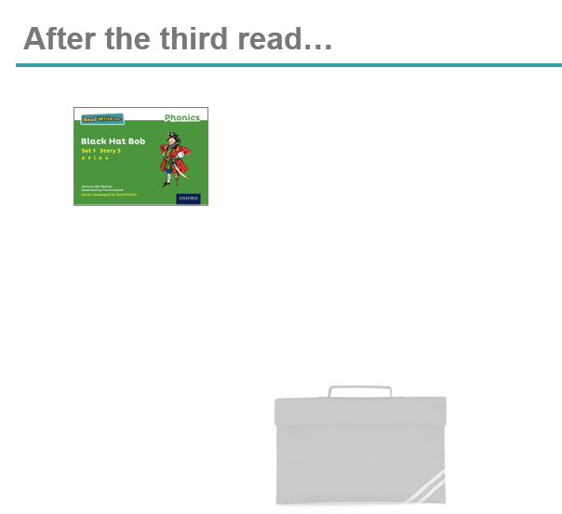
The children bring the same Storybook home in their book bag.
They love this book!
They can read it like a storyteller and can’t wait to read it to you.

Slide 9
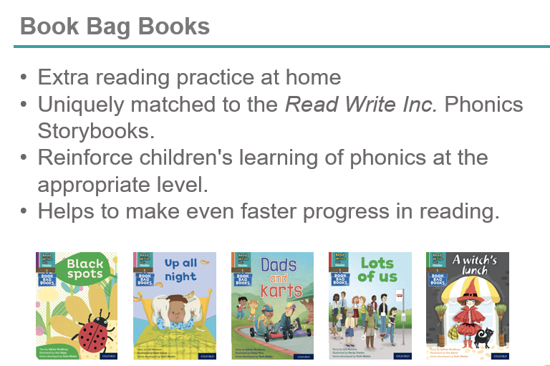
Book Bag Books

Slide 10
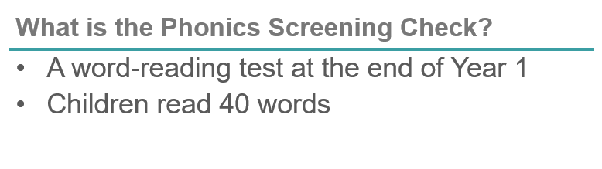
Phonic Screening Check
https://schools.ruthmiskin.com/training/view/j5V0TdAB/cy45rPqD

Slide 11
Phonic Screening Check
Children complete a word-reading check at the end of Year 1 so that parents can be confident their children are being taught to read successfully.
Children read 40 words. It takes between two and five minutes.
If they do not manage to read 32 of the words, they are given extra support, and repeat the check at the end of Year 2.
It means that all children will be able to read accurately before they begin Year 3.
In our school, we aim to make sure that every child learns to read accurately by the end of Year 1 so they are set up for success in school and in life.
As soon as we spot a child who needs extra practice learning to read sounds and words, we teach them one-to-one for a few minutes every day.

Slide 12

Phonic Screening Check
We teach children to read both real and nonsense words using the routine ‘Special Friends’, ‘Fred Talk’, read the word’.
Children spot the ‘Special Friends’ (two letters that make one sound), Fred talk the word, and then read the word as a whole.
For example, ‘sh’, sh-i-p, ship.

Slide 13
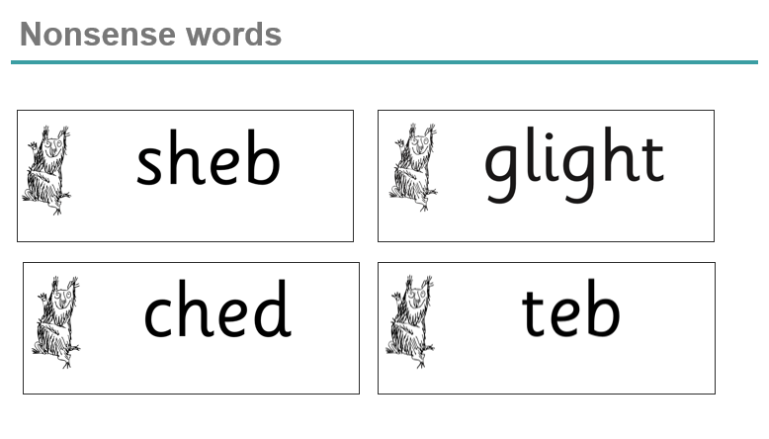
Phonic Screening Check
Half of the words in the check are real words.
Half are nonsense words. For example, ‘sheb’, ‘glight’, ‘ched’, ‘teb’.
There is a picture of an alien next to each word to remind the children that it isn’t a real word.

Slide 14
Phonic Screening Check
Nonsense words check that children will be able to read sounds they know in unfamiliar words.
Children who can read nonsense words will, very soon, be able to read any new word.
Reading new words increases children’s vocabulary rapidly.

Slide 15
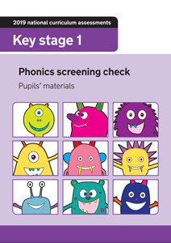
Phonic Screening Check
The children have had two mock phonic screening checks so they have been exposed to the format of the check
The check is carried out by their class teacher and is done 1:1

Slide 16
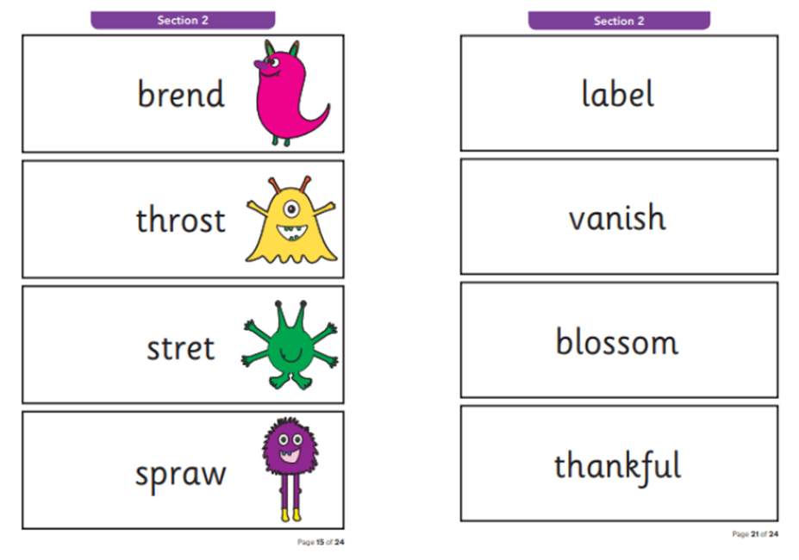
Phonic Screening Check
The check is split into two sections.
Section 1 will be CVC and words containing set 1 sounds
Section 2 will be words with “special friends” and set 2 and 3 sounds

