Slide 1
Online Safety Workshop

Slide 2
Agenda
Introduction
Children’s use of computing
The issues that children face online
Computing @ Ghyllgrove
Useful links and resources

Slide 3

How children spend their time online

Slide 4











The online world can be exciting and inspiring.
But it can have potential risks and it is important to manage and prevent these.

Slide 5
The Issues children face online
Grooming
Sexting
Cyberbullying

Slide 6
What is Grooming?
Grooming is when someone builds a relationship, trust and emotional connection with a child or young person so they can manipulate, exploit and abuse them.
Anybody can be a groomer, no matter their age, gender or race. Grooming can take place over a short or long period of time – from weeks to years. Groomers may also build a relationship with the young person's family or friends to make them seem trustworthy or authoritative.

Slide 7
Advice on Grooming
Discuss online friendships with your child – remind them that someone they have never met face-to-face is still a stranger. Discuss what kinds of information should be shared online.
Ensure they know they come to you if they have any concerns or worries.
If you have any suspicions whatsoever about someone who is in contact with your child online, report it to CEOP.

Slide 8
What is Cyberbullying?
Cyberbullying is bullying that takes place online. Unlike bullying offline, online bullying can follow the child wherever they go, via social networks, gaming and mobile phone.

Slide 9
Advice on Cyberbullying
Discuss cyberbullying with your child – teach the importance of online respect and make sure they know they can talk to you if they have any worries or concerns.
If they are a victim:
DO save the evidence.
DO report to the school/police.
DO use online tools to block/report the perpetrator.
DON’T deny your child access to a device or service. They may feel punished when they are the victim.
DON’T retaliate.

Slide 10
What is Sexting?
When a child is sexually exploited online they might be persuaded or forced to:
send or post sexually explicit images of themselves
film or stream sexual activities
have sexual conversations.

Slide 11
Advice on Sexting
Discuss sexting with your child – ensure they know that once information goes out there, it is very difficult to get back and the consequences can be very upsetting.
Make sure they know they can talk to you if they have any concerns or worries.
With younger children, discuss which parts of their body should be kept private.
DO seek advice from the school if you need further support.
DO report it to the police or CEOP if you have any suspicions about the involvement of an adult or think your child has been coerced.

Slide 12
An open and honest dialogue with your child is absolutely key.
Talk to your child about their internet use. Let them know they can talk to you.

Slide 13
Establish boundaries and your expectations.
Filtering software and locking down the privacy settings can help block unwanted content.

Slide 14
Familiarise yourself with safety and privacy settings on the devices your family uses.
Learn how to block/mute other users on games and social media sites.

Slide 15
Get involved with your child’s life online. Learn about the apps, games and devices they use.
Play their favourite games with them, try out their favourite apps.

Slide 16

Encourage your child to always ‘Think before you post’
Give your child strategies to cope with content they don’t want to see.
Lead by example and discuss the content you post on social media.
For example, speaking to you or turning off the device.

Slide 17
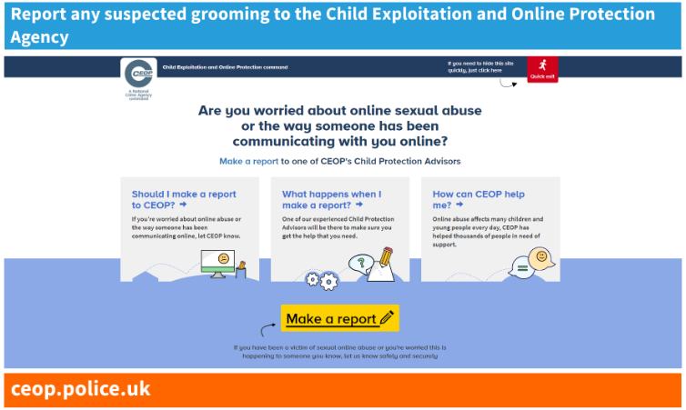
Reporting to CEOP

Slide 18
Online Safety @ Ghyllgrove

Slide 19
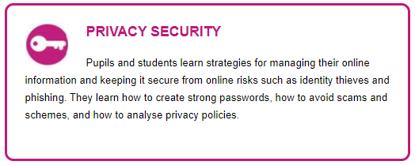

Slide 20
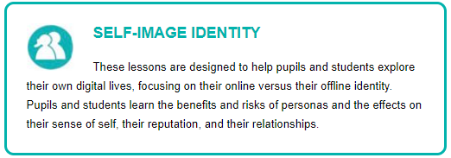

Slide 21
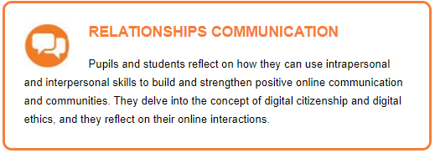

Slide 22
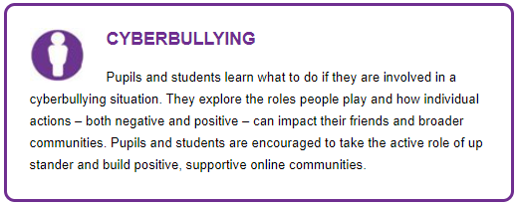

Slide 23


Slide 24
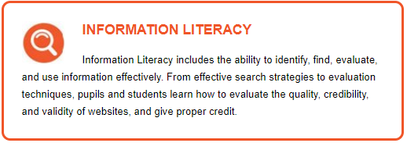

Slide 25
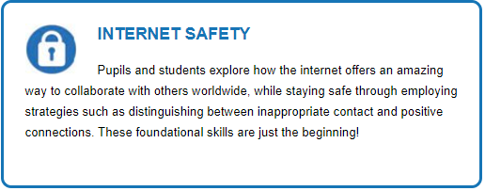

Slide 26

Useful Resources

Slide 27
Useful Resources

