Slide 1

Welcome to Year 4
Parent workshop

Slide 2
Aims:
Meet the Year 4 Teachers
Know the curriculum your child will be taught this year
School behaviour system
RSE in Year 4
How to support your child at home

Slide 3
Maths
Summary of Maths expectations for the year group.
Children are confident and know all the written methods for the 4 calculations.
Children are expected to understand common fractions and solve simple calculations involving fractions.
They will begin to look at decimals and fractions equivalents.
Children to apply arithmetic skills when solving reasoning problems.
Times tables expectation.
In June the children will sit the MTC.
By the end of Year 4 all children are expected to know all their times tables up to X12.
Children can use TTRS to help with their times tables recall.

Slide 4
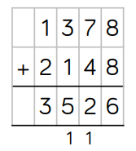
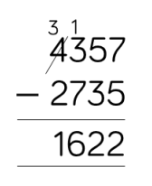
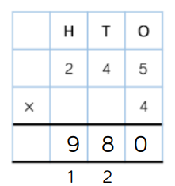
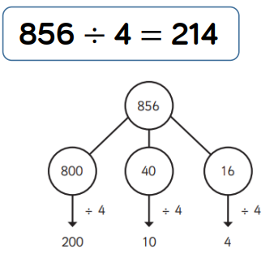
Maths

Slide 5
Maths
Encourage and support them to complete their weekly homework on Google Classrooms. Maths homework is set on alternate weeks.
Help your child practise their times tables. Little and often works best.
Encourage your child to use TTRS at home.
Look out for our helping your child at home with Maths parent workshop later this term.

Slide 6
English
In year 4 English is delivered through a book centred approach which engages the children in high level texts, stimulates their creative writing ideas and gives a model for spelling, punctuation and grammar.
These texts are: The Iron Man, Beaver Towers and How to Train your Dragon – How to be a Pirate.
Children will be taught how to read fluently and with expression in their fluency lessons and taught the key skills of comprehension
By the end of Year 4 children are expected to be able to organise their ideas in paragraphs, ensure their writing is coherent and their writing has a clear structure.
Read a variety of texts fluently and with expression
Read for understanding by retrieving information and begin to use clues in the text to answer questions
Spell phonetically plausible words and common exception words for 3 & 4
Use capital letters, full stops, commas in a list, question marks, exclamation marks demarcate a range of sentences
To use commas to mark adverbial phrases and subordinate clauses
Use adjective, adverbs, exciting verbs and a variety of conjunctions within their writing

Slide 7
English
Please help your child at home by asking them to read to you at least three times a week and sign their home school diary so they can achieve their reading certificates.
Share books with them and read books to them – these can be their school reading book, a book from home or the library.
Encourage and support them to complete their weekly homework on Google Classrooms. English homework is set on alternate weeks.
Practise their weekly spellings.

Slide 8
Topic – Foundation Curriculum
In year 4 children will be learning new skills and building knowledge of history, geography, science, art, music and DT through 6 topics this year.
The topics are:
Rocking Romans | Mad Scientists | Essex Explorers | What's that living thing? | Rock Stars | WWII
Children also follow a computing curriculum where they learn Online Safety, Basic skills – typing, copy and paste, searching, saving and opening work, photo editing etc
They are also taught about religion through RE and this year having a focus on Theology, philosophy and the human/social sciences as they are all rooted in intellectual traditions. They each ask different questions about religion and worldviews. We need a balance between them.
Children continue to learn French through a range of topics including All about Me, Games and Songs and Celebrations and we learn about other countries and cultures through our MFL days.
PE will be taught twice a week and children will learn progressive skills through games, dance and gymnastics sessions. They will need the correct PE kit of red shorts and a white t-shirt and trainers for indoors and a plain back joggers and jumper (tracksuit) and trainers for outdoor PE

Slide 9
SWIMMING
Swimming takes place every week in the afternoon. Children will only swim in Year 4 for the whole year. We hope the consistency in swimming weekly helps children gain confidence in the water.
By the end of Year 4 the expectation is that all children will be able to swim 25m in a stroke of their choice.
Children will need bring a towel, swimming costume and a swimming hat.
Autumn term
Class 13 and 15 – Wednesday
Class 14 - Wednesday

Slide 10
Foundation Curriculum
PE will be taught weekly and children will learn progressive skills through games, dance and gymnastics sessions.
They will need the correct PE kit:
Red shorts
White t-shirt
Trainers
Plain back joggers and jumper (tracksuit) for outdoor PE in colder weather
Our PE days are:
Class 13: Monday
Class 14: Monday
Class 15: Friday

Slide 11
RSE in Year 4
It is now statutory that all children learn about relationships and sex education.
As a school we follow Dfe guidance on what should be taught and have planned a curriculum that best fits the needs of the children at each stage of their development.
In year 4 children will learn:
Health and well being – how to stay physically and mentally healthy
Relationships – how to build trusting friendships and understand other opinions and feelings.
Being Safe – both online and in day to day living
Living in the wider world
Aspirations - to know how to set goals and achievable targets.

Slide 12

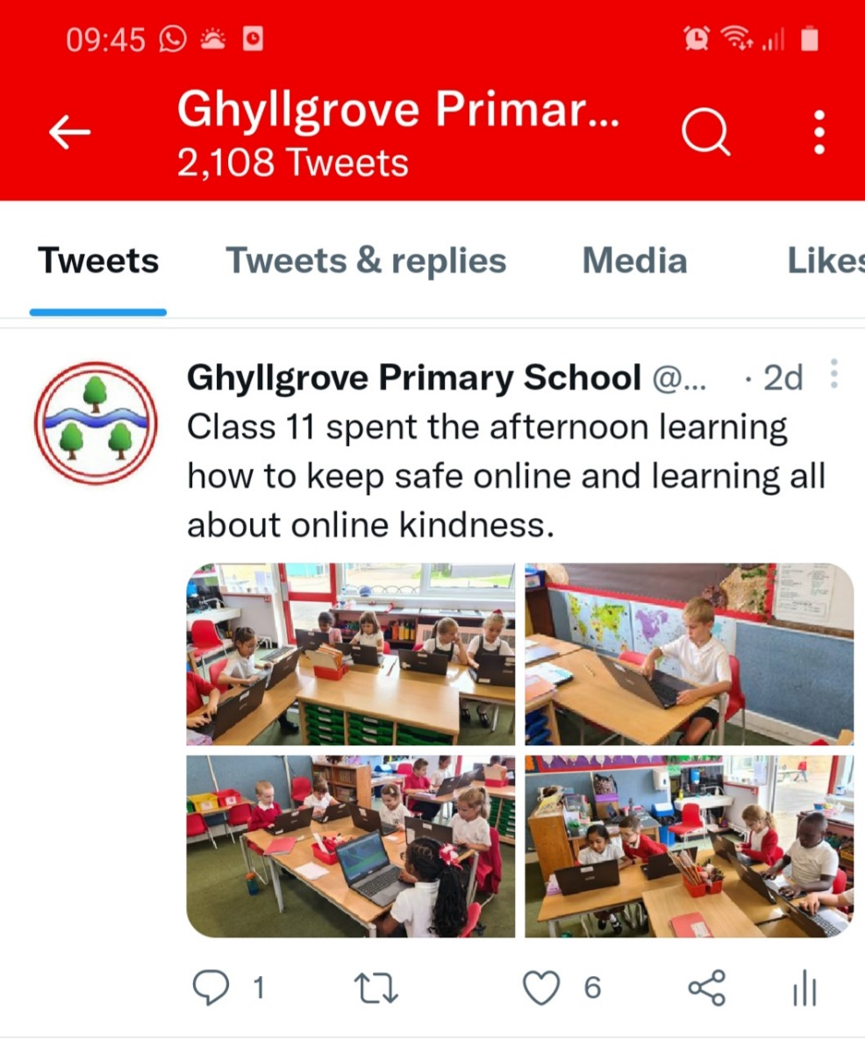

Keeping up to date

Slide 13
Behaviour school rules rewards & sanctions
7 daily habits
The school behaviour system is consistent throughout the primary school and you can still expect to see Green Certificates at the end of the week.
In school children will learn the school rules and learn how to make good, kind and respectful choices. There are many rewards for following school rules and making good choices such as positive praise, stickers, golden time, team tokens, certificates and bronze, silver and gold awards. This year children have the chance to win the Headteachers Special Award for outstanding behaviours in school.
There are sanctions when the school rules are not followed and children know what these are. When children lose all three chances in class or break a school rule they can receive a verbal warning and for more serious behaviours a written warning. Please look out and praise your child when they receive a green certificate and a yellow certificate. If they do not bring a certificate home it could be worth checking with the teacher why not if they have not already spoken to you.

Slide 14
If you have any concerns or worries please email or call into the school and we will arrange a time to chat with you.

