Slide 1

Welcome to Year 3
Parent workshop

Slide 2
Aims:
Meet the Year 3 Teachers
Know the curriculum your child will be taught this year
School behaviour system
RSE in Year 3
How to support your child at home

Slide 3
Maths
By the end of Year 3 children are expected to:
Read, write, compare and order numbers up to 1000 in digits and words.
Understand place value in 3 digit numbers up to 1000.
Add and subtract numbers up to two 3 digit numbers (for example 854-273).
Add and subtract small amounts and multiples of 10 and 100 mentally.
Multiply and divide 2 digit numbers by using their times tables skills.
Find fractions of objects, shapes and amounts.
Add, subtract, compare and order fractions.
Measure, compare, order and calculate when working with length, height, weight, capacity, temperature and money.
Identify 2D and 3D shapes and know their properties.
Calculate the perimeter of a shape.
Times tables expectation.
By the end of Year 3 children are expected to know their 3, 4 and 8 times tables as well as their 2’s, 5’s and 10’s from previous year groups.
Children can use TTRS to help with their times tables recall.
Children can use their home school diary for support with their timetables.

Slide 4
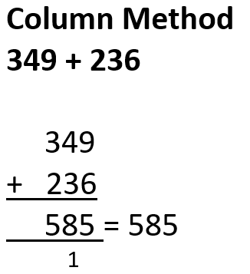
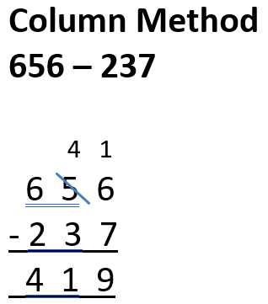
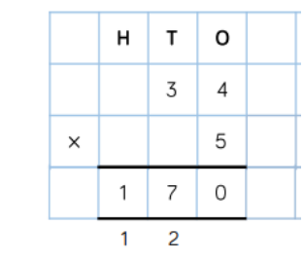
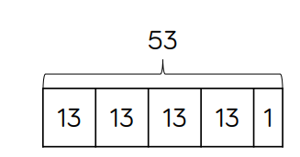
Maths
Methods used for addition, subtraction, multiplication and division Year 3.

Slide 5
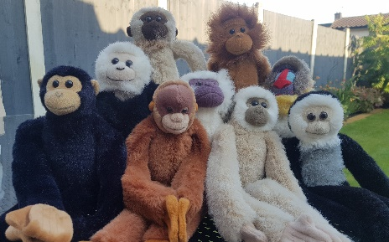
Maths
Encourage and support them to complete their weekly homework on Google Classrooms. Maths homework is set on alternate weeks.
Look out for Maths Monkey! He will be coming home for the weekend with each child this year. He has a box full of exciting Maths activities for you and your child to use.
Help your child practise their times tables. Little and often works best.
Encourage your child to use TTRS at home.
Look out for our helping your child at home with Maths parent workshop later this term.

Slide 6
English
In Year 3, English is delivered through a book centred approach which engages the children in high level texts, stimulates their creative writing ideas and gives a model for spelling, punctuation and grammar.
These texts are: The Enormous Crocodile, Leonora Bolt, Jake Cake and the Werewolf Teacher then Jake Cake and the missing mummy.
Children will be taught how to read fluently and with expression in their fluency lessons and taught the key skills of comprehension.
By the end of Year 3 children are expected to:
Organise their ideas into detailed sentences, ensure their writing is coherent has a clear structure.
Read a variety of texts fluently and with expression.
Read for understanding by retrieving information and begin to use clues in the text to answer questions.
Spell phonetically plausible words and common exception words for Years 1 , 2 and 3.
Use capital letters, full stops, commas in a list, question marks and exclamation marks to demarcate a range of sentences.
Use interesting vocabulary and a variety of conjunctions within their writing.

Slide 7
English
Please help your child at home by asking them to read to you at least three times a week and sign their home school diary so they can achieve their reading certificates.
Share books with them and read books to them – these can be their school reading book, a book from home or the library.
Encourage and support them to complete their weekly homework on Google Classrooms. English homework is set on alternate weeks.
Practise their weekly spellings.

Slide 8
Foundation Curriculum
In Year 3 children will be learning new skills and building knowledge of History, Geography, Science, Art, Music and DT through 6 topics this year.
The topics are:
Time Travellers | The Invisible Force | Beneath our Feet | Green Fingers | Brilliant Bodies | Egyptians
Children also follow a computing curriculum where they learn how to keep themselves safe and a range of computer literacy skills, including typing, copy and paste, searching, saving and opening work and photo editing.
They are also taught about religion through RE which follows the Discovery Scheme of work and in Year 3 we will be focusing on the world’s main religions e.g. Christianity and Hinduism. This helps the children to develop an understanding of different people in their community.
Children will begin learning French through a range of topics including: All about Me, Games and Songs and Celebrations. We will also learn about other countries and cultures through our Modern Foreign Language days and Language of the Month.

Slide 9
Foundation Curriculum
PE will be taught twice a week and children will learn progressive skills through games, dance and gymnastics sessions.
They will need the correct PE kit:
Red shorts
White t-shirt
Trainers
Plain back joggers and jumper (tracksuit) for outdoor PE in colder weather
Our PE days are:
Class 10: Wednesday and Thursday
Class 11: Monday and Wednesday
Class 12: Monday and Tuesday

Slide 10
RSE in Year 3
It is now statutory that all children learn about relationships and sex education.
As a school we follow DfE guidance on what should be taught and have planned a curriculum that best fits the needs of the children at each stage of their development.
In Year 3, children will learn about these topics:
Healthy Life Styles (personal hygiene and active lifestyles)
Growing, Changing and Reproducing (that growing takes times, how we change as we grow)
First Aid (shocks and cuts)
Feeling and Emotions (emotions and why we feel them)
Families and Friendships (showing good manner, kindness and what makes a good friend)
Respectful relationships (respect, bullying)
Living with others (team work and group work)
The Environment (how we can improve the environment)
Money Management (saving money)
Aspirations (growth mindset and knowing our own strengths)

Slide 11

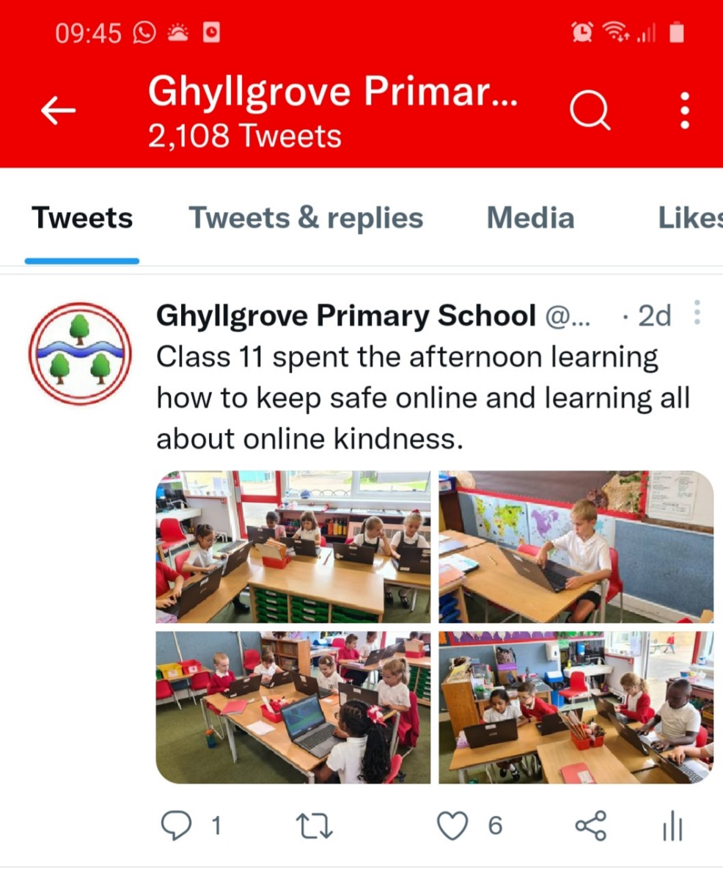

Keeping up to date

Slide 12

Something very exciting!
Growing sessions: Children learn how to sow, transplant and care for a variety of different crops in different situations (raised beds, pots and buckets).
Cooking sessions: Children learn to cook several different dishes and have the opportunity to taste new things using seasonal and local produce.
Farm visit: Children visit a real, working farm and spend some time getting to know the farmer and learning about what a farmer's life is like. We help them to see the connection between the countryside, farming and the food they eat.
Playground market: Children run a mini farmers' market at school for parents. They conduct research to decide what will sell best. Having promoted the market, the children order the produce they wish to sell, weigh it out, price it and sell it!
Local Food Hero session: A local farmer or food producer comes to school to talk about the work they do (and hopefully bring samples to taste and touch!).
Learning journal session: Children reflect on what they have learnt and experienced. They keep journals with photos, notes, pictures and keepsakes.
Harvest Feast: At the end of the year, pupils harvest the fruit and vegetables they have grown and cook them up to share a feast together!

Slide 13
Behaviour: School rules, rewards & sanctions, 7 daily habits
The school behaviour system is consistent throughout the primary school and you can still expect to see Green Certificates at the end of the week.
In school, children will learn the school rules and learn how to make good, kind and respectful choices. There are many rewards for following school rules and making good choices such as positive praise, stickers, golden time, team tokens, certificates and bronze, silver and gold awards. This year children have the chance to win the Headteachers’ Special Award for outstanding behaviours in school.
There are sanctions when the school rules are not followed and children know what these are. When children lose all three chances in class or break a school rule they can receive a verbal warning and for more serious behaviours a written warning. Please look out and praise your child when they receive a green certificate and a yellow certificate. If they do not bring a certificate home it could be worth checking with the teacher why not if they have not already spoken to you.

Slide 14
If you have any concerns or worries please email or call into the school and we will arrange a time to chat with you. parents@ ghyllgrove.essex.sch.uk

Slide 15
QUESTION TIME!

